Slide 1
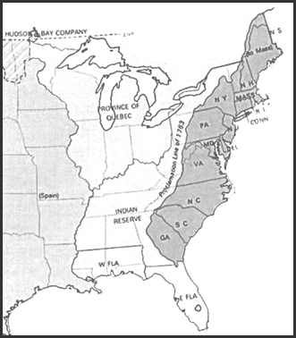
13 English Colonies

Slide 2
Ohio Standard-
Analyze how physical characteristics of the environment influenced population distribution, settlement patterns, and economic activities in the United States during the 18th and 19th centuries.
Trace the development of religious diversity in the colonies, and analyze how the concept of religious freedom has evolved in the United States.

Slide 3
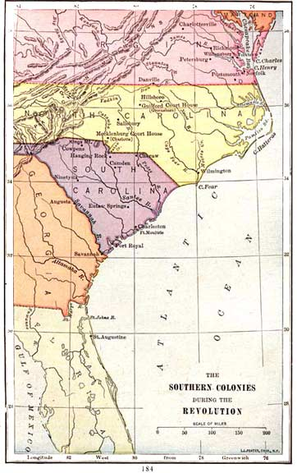
Southern Colonies
What five Colonies Made Up England’s Southern colonies?
Maryland, Virginia, North Carolina, South Carolina, and Georgia

Slide 4
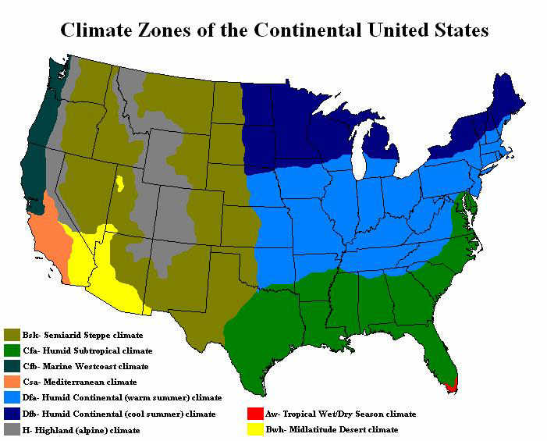
Southern Colonies
Have a warm climate with a long summer
Wide flat coastal Plain with very fertile soil.
What economic activity(s) would this be good for?

Slide 5
Economy
Careful use or management of resources such as money, materials, or labor

Slide 6
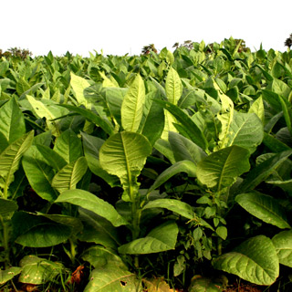
Southern Economy
The economy was based on Agriculture
Large plantations developed that usually raise cash crops such as Tobacco, Indigo, and Rice
Also earned a little money producing naval supplies, and iron goods

Slide 7
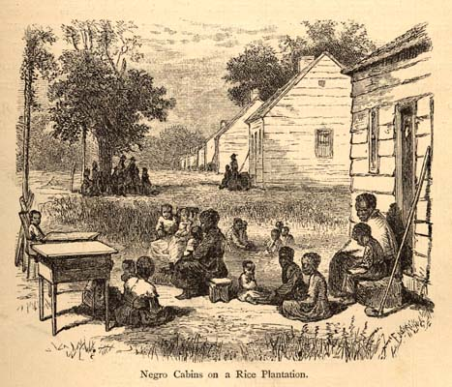
Labor in the Southern Colonies
Much of the labor in the South is provided by Slaves
In 1660 slaves make up about 4% of the colonial population
By 1780 slaves make up 20% of the colonial population.

Slide 8
Settlement Patterns in the Southern Colonies
Most southerners live along rivers away from the coast.
There are few towns and people live far from their neighbors
Because people do not live in towns, education is very difficult to get
Poorer children are educated by their parents at home
Wealthy send their children to boarding schools in England or hire tutors to educate their children

Slide 9
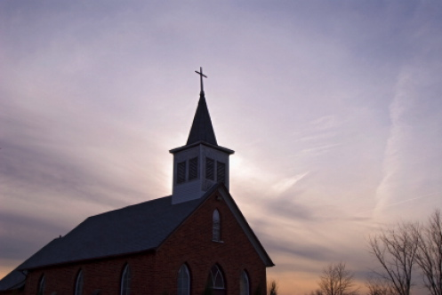
Ethnic and Religious Background of Southern Colonist
Most free citizens are of English Ancestry and worship in an Anglican Church (Church of England)

Slide 10
Government in Southern Colonies
Because the Southern Colonies have few towns and live far apart from one another, they set up a representative government
Example:
Virginia’s House of Burgesses
Makes laws and decisions for the colony (VA) with the governor’s approval
Each of VAs counties elects a representative to represent the colonists’ interests

Slide 11
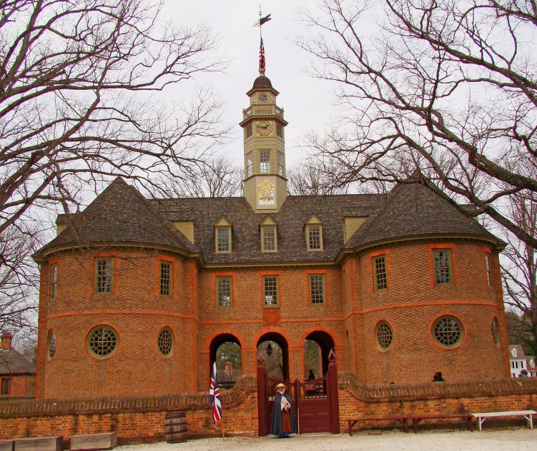
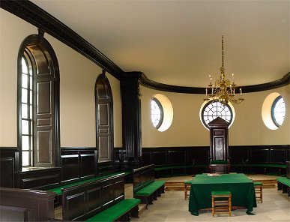
Government in the Southern Colonies
Significance:
The House of Burgesses established a tradition of representative government in England’s colonies

Slide 12
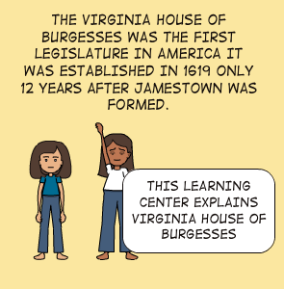
Significance of House of Burgesses

Slide 13
Exit Slip
On a half sheet of notebook paper (nothing smaller)answer the following question-
Explain how the environment influenced life in the 5 southern colonies. Be sure to consider settlement patterns, economic base, education and religion. (4 points)

