Slide 1
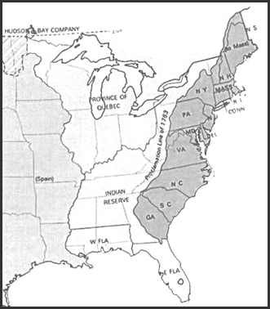
13 English Colonies

Slide 2
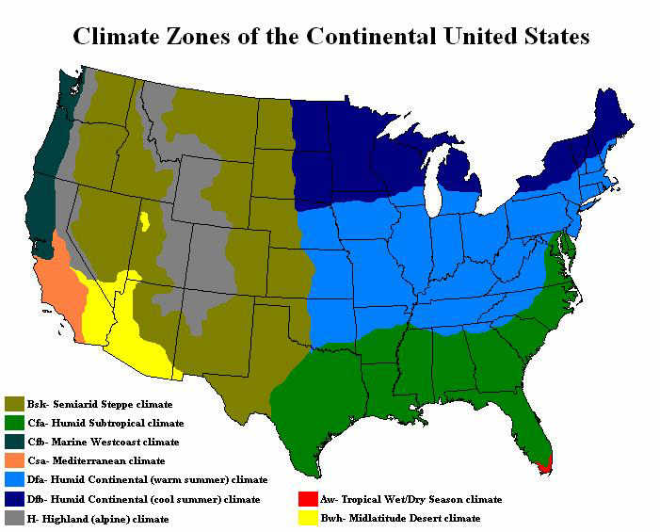
New England Environment
The New England Colonies had a climate with short, warm summers, long cold winters, with plenty of rainfall
Had a narrow coastal plain with thin, rocky, infertile soil and a jagged coastline with many deep water ocean inlets.
What economic pursuits would this be good for?

Slide 3
New England Economy
Small family run farms produce enough food to support New England but little if any surplus for trade

Slide 4
New England Economy
Most New Englanders are involved in
Trade
Fishing
Manufacturing
Whaling
Shipbuilding
Fur Trade
Depend on wage labor system so have few slaves or indentured servants
Wage Labor- People paid for work the do.

Slide 5
New England Settlement Patterns
Many small towns located near the coast

Slide 6
Religion in New England
Most settlers in New England were of English decent
The Puritans were the first to settle in New England so the Puritan Church is the dominant religion and has a great influence on all aspects of life.
Because people live in towns and strong Puritan influence New England had many public schools and a highly educated and skilled labor source
Rhode Island is formed from Puritan Dissenters and will offer religious toleration

Slide 7
Assignment
In a half piece of notebook paper
Identify one thing that you would like to change about your Social Studies Class
Identify one thing that you would like to change about Roberts Middle School

Slide 8
Government in New England
Town Meetings
Each town would regularly have meetings of all citizens would get together in the church to discuss issues of local importance (ie- paying for schools)
Male, Property owners that were members of the Puritan church could vote on important matters and elect representatives to General Court

Slide 9
Government in New England
General Court
Representatives from each town would write laws for the entire colony
Laws written by the General Court could be vetoed by the Governor or the Privy Council
Privy Council- A group of officials appointed by King to represent the King’s interest in the colonies. This council could overturn any decision made by the colonial legislture.

