Slide 1
Colonizing America
Europeans Settle the New World

Slide 2
Cause of European Colonization
Push Factors- a negative aspect or condition that motivates one to leave a location
Pull Factor- A quality or attribute that attracts people to a location

Slide 3
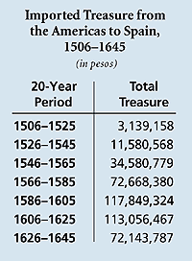
Spain
Massive Pull Factor
From 1503 – 1660 Spain took 200,000 tons gold & 18,600 tons silver from NA

Slide 4
Spain
Begins to build settlements (colonies) in the South and Central America
Land owned by the crown (Government)
Colonies strictly controlled by King
Citizens have no say in Government and few freedoms
Economy based on Mercantilism
The practice of creating and maintaining wealth by carefully controlling trade

Slide 5
Spanish Colonies
Colonies created to
Find and ship valuable raw materials to ship to Spain (GOLD)
Purchase finished goods from Spain to boost the Spanish Economy
This trade creates wealth for Spain

Slide 6
Native Americans
Initially Spain largely sees Native Americans as a useable labor source
Spain also attempts to covert Native population to Catholicism
Spain will eventually turn to African slaves to provide needed labor

Slide 7
Spanish Colonies
Catholic church has much influence over society
Spanish build missions to convert Native Americans to Catholic faith
Mission- settlements built by priests in Spanish America to convert Native Americans to Catholicism
Spanish encourage intermarriage with Native Americans

Slide 8
How has Spanish Colonization Effected the Americas?

Slide 9
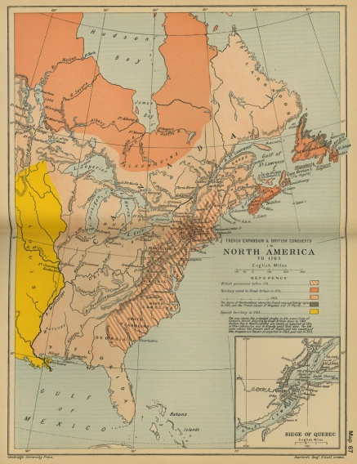
France
France begins to explore North America
To find Northwest Passage
Spread Catholic faith to Native Americans
Settle Acadia (Newfoundland) early 1600s

Slide 10
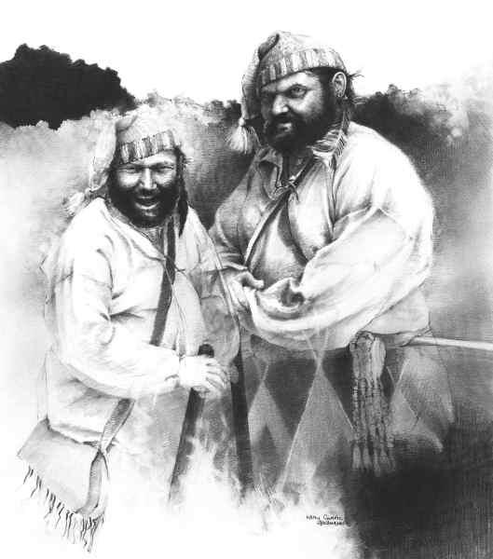
France
Do not find Northwest Passage but
Claim most of North America
Discover that can earn $ through fur trade

Slide 11
France
Colonies
Owned by crown
Government strictly controlled by crown
Gov’t. encourages interaction with Indians through the trade of fur
Economy based on Mercantilism
Greatly influenced by Catholic Church

Slide 12
Exit Slip
On a half sheet of paper answer the following-
List 3 similarities between the Spanish and French colonies in America
List 2 differences between the Spanish and French colonies in America
The thing I understand least about Spanish and French colonization is…

Slide 13
England
Wants to colonize because they fear
Will economically fall behind European nations that have colonies
All of the New World will be controlled by Catholics
Also believe could solve other domestic problems

Slide 14
Roanoke

