Slide 1
England Colonizes North America
Unit 2- European colonization

Slide 2
England Slow to Colonize
England does not have a successful colony until 1607
‘til then they lack adequate funds and military power to support colonies

Slide 3
Convincing the King
London business owners convince King James to grant a charter to settle in Virginia. Tell king that
Colony would find valuable resources to ship to England
Colony would provide a market for English finished goods
Colony would solve social problems in England
Colonists could spread Protestant faith

Slide 4
What economic system would this be???

Slide 5
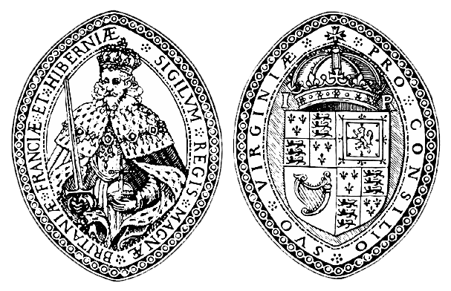
London Company
London investors form a joint stock company so colony is not dependent on one person’s wealth
Company called the London Company

Slide 6
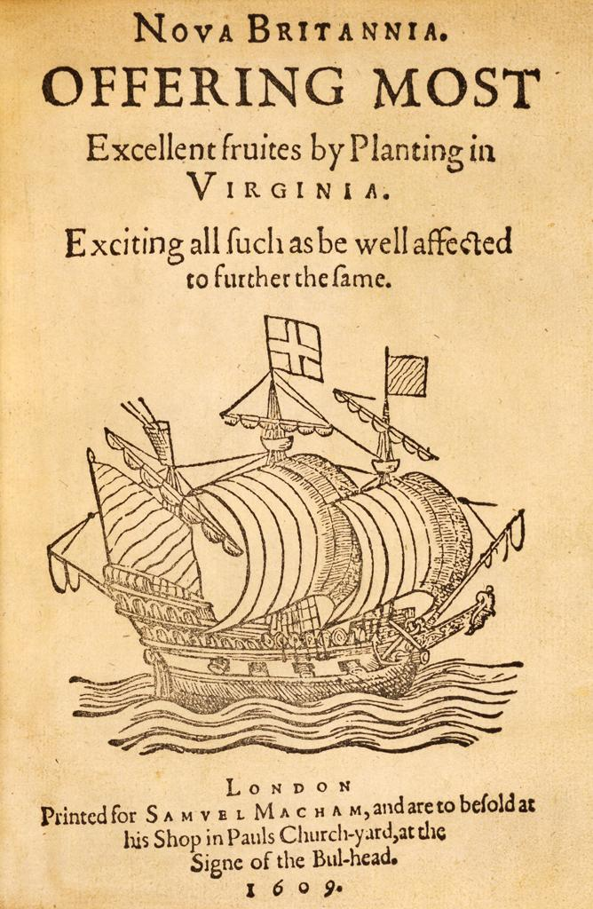
London Company
Prints advertisements to attract investors and settlers
Praise Virginia
Promise wealth and fame

Slide 7
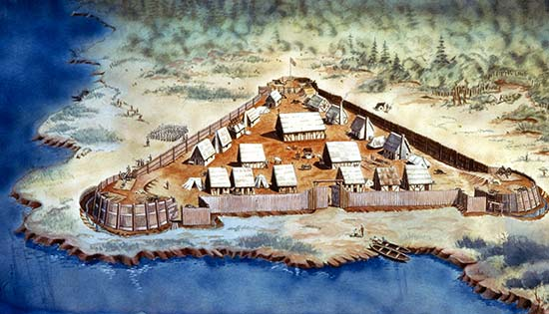
Jamestown
1607 three ships land on Virginia coast
105 MEN build a settlement along James River
Set out to make their fortune for themselves and London Company

Slide 8
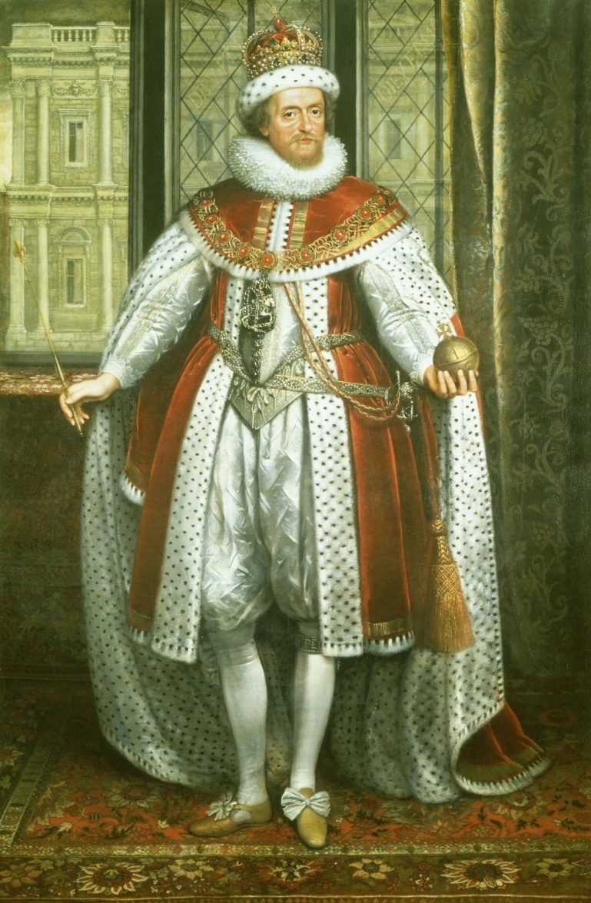
London Company
Since the London Company has taken all of the financial risk, King gives the company much control over governing the colony

