Slide 1
Introduction to the Porgressive Era
1900 - 1917

Slide 2
What does Progressive mean???
Ok … apply it to society.
What was the Progressive Movement in America???

Slide 3
1890 to 1917
Progressives were reformers who attempt to solve problems caused by industry, growth of cities, and laissez faire capitalism

Slide 4
Adopt Populist Ideas
What do Populists believe?
Move away from laissez faire with government regulation of industry
Make US government responsive to people (voting)
Limit the power of political bosses.
Improve worker’s rights, conditions for poor and immigrants
Clean up the cities
End segregation and Jim Crow

Slide 5
Populists vs Progressives
Populists | Progressives
Rural | Cities
Poor | Middle Class
Uneducated | Educated
Too radical | Political mainstream
What did the Populists push for?
Graduated income tax
Coinage of Silver
Direct election of Senators
Government regulation of railroads

Slide 6
Populists vs Progressives
Populist FAILED
Progressives SUCCEEDED

Slide 7
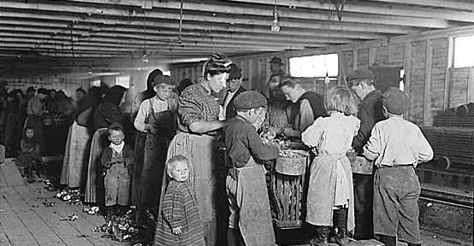
Social Justice
Improve working conditions in industry, regulate unfair business practices, eliminate child labor, help immigrants an the poor.

Slide 8
Political Democracy
Give the government back to the people, get MORE PEOPLE VOTING and END CORRUPTION with political machines.

Slide 10
Economic Justice
Fairness and Opportunity in the work world, REGULATE unfair trusts and bring about changes in labor.
Demonstrate to the common people that the US Government is in charge and NOT the industrialists

Slide 11
Do you know who the Muckrakers were?
MR Koch, Mr. Koch…
I know
I know

Slide 12
Yes-
Muckrakers believe that if the public could only see or read for itself there would be an outcry and people would want to make conditions better or demand that government make reforms
“Digging up the dirt” = Investigative Journalism

Slide 13
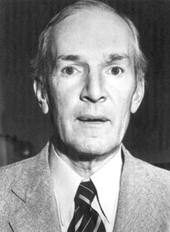
Upton Sinclair
Upton Sinclair, The Jungle, exposed the filthy, unsanitary working conditions and corruption in a Chicago meatpacking company

Slide 14
Upton Sinclair- The Jungle
Of the butchers and floorsmen, the beef boners and trimmers, and all those who used knives, you could scarcely find a person who had the use of his thumb; time and time again the base of it had been slashed, till it was a mere lump of flesh against which the man pressed the knife to hold it. The hands of these men would be crisscrossed with cuts, until you could no longer pretend to count them or trace them. They would have no nails,—they had worn them off pulling hides; their knuckles were swollen so that their fingers spread out like a fan. There were men who had worked in the cooking rooms, in the midst of steam and sickening odors, by artificial light; in these rooms the germs of tuberculosis might live for two years, but the supply was renewed every hour. There were the beef luggers, who carried two-hundred-pound quarters into the refrigerator cars, a fearful kind of work, that began at four o'clock in the morning, and that wore out the most powerful men in two years. There were those who worked in the chilling rooms, and whose special disease was rheumatism, the time limit that a man could work in the chilling rooms was said to be five years. There were the wool pluckers, whose hands went to pieces even sooner than the hands of the pickle men; for the pelts of sheep had to be painted with acid to loosen the wool, and then the pluckers had to pull out this wool with their bare hands, till the acid had eaten their fingers off. There were those who made tile tins for the canned meat, and their hands, too, were a maze of cuts, and each cut represented a chance for blood poisoning. Some worked at the stamping machines, and it was very seldom that one could work long there at the pace that was set, and not give out and forget himself, and have a part of his hand chopped off. There were the "hoisters," as they were called, whose task it was to press the level which lifted the dead cattle off the floor. They ran along upon a rafter, peering down through the damp and the steam, and as old Dunham's architects had not built the killing room for the convenience of the hoisters, at every few feet they would have to stop under a beam, say four feet above the one they ran on, which got them into the habit of stooping, so that in a few years they were walking like chimpanzees. Worst of any, however, were the fertilizer men, and those who served in the cooking rooms. These men could not be shown to the visitor—for the odor of a fertilizer man would scare any ordinary visitor at a hundred yards, and as for the other men, who worked in the tank rooms full of steam, and in some of which there were open vats near the level of the floor, their peculiar trouble was that they fell into the vats; and when they were fished out, there was never enough of them left to be worth exhibiting—sometimes they would be overlooked for days, till all but the bones of them had gone out to the world as Dunham's Pure Beef Lard!

Slide 15
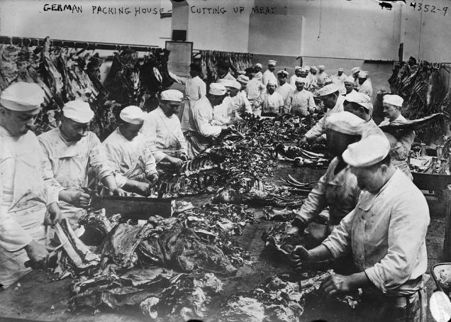

Slide 16
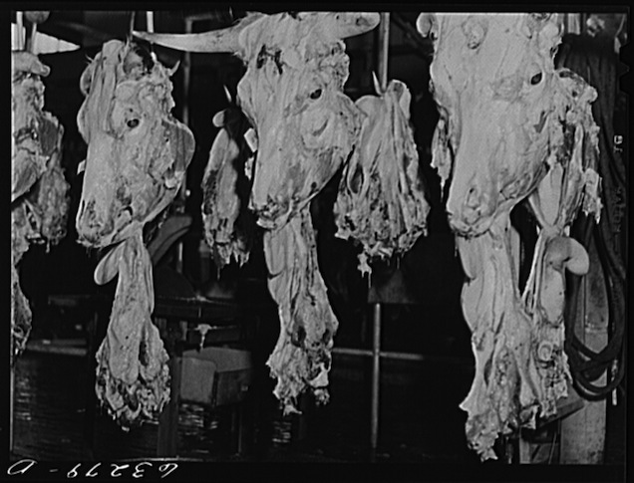

Slide 17
