Slide 1
Life during the Great Depression
Hard Times
Pages 448 - 455

Slide 2
Hardship and suffering during the Depression
During the Great Depression Americans did what they had to do to survive

Slide 3
The Depression Devastates People’s Lives
All across America, people were evicted from their homes:
Some lived in parks or on the street
Others built a makeshift shack out of scrap materials
Communities of these shacks were called shantytowns.
Also known as Hoovervilles

Slide 4
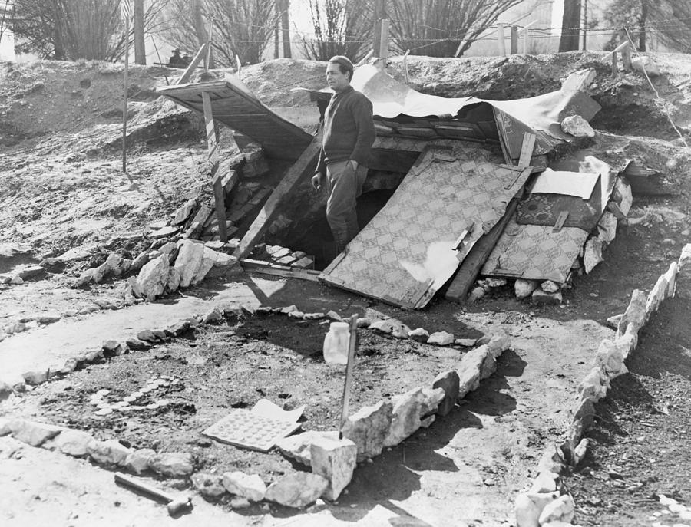

Slide 5
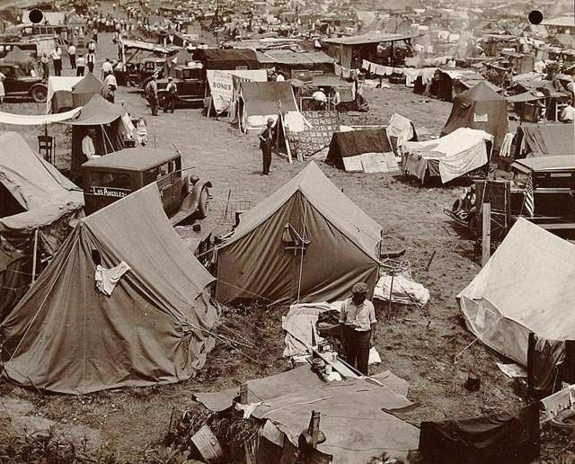

Slide 6
Depression sets in
Everyday the poor dug through garbage cans for food
Soon soup kitchens were set up to offer free or low cost food
Long lines of people (breadlines) became a common sight

Slide 7
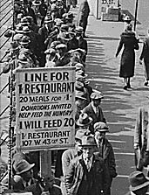

Slide 8
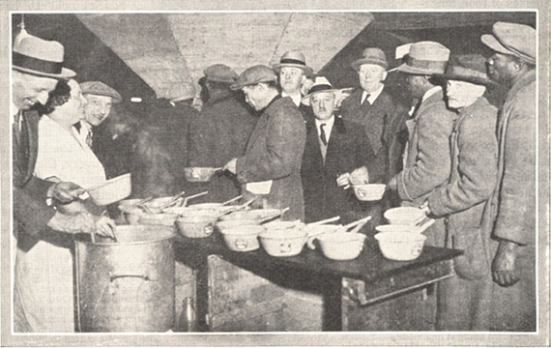

Slide 9
Great Depression Effect on Rural Areas
Most farmers could grow food for their own families
Unfortunately, food prices were falling drastically
Farmers tried selling anything to pay their bills
1929 – 1932
400,000 farms were lost through foreclosure
Mortgage holder takes back property for no payment

Slide 10
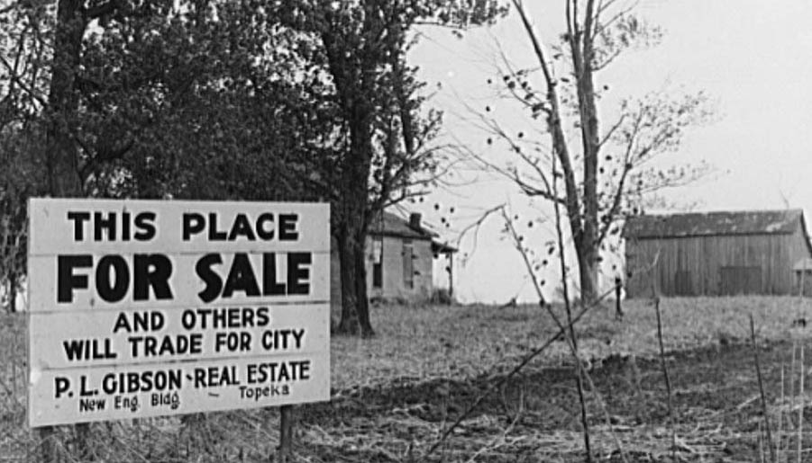

Slide 11
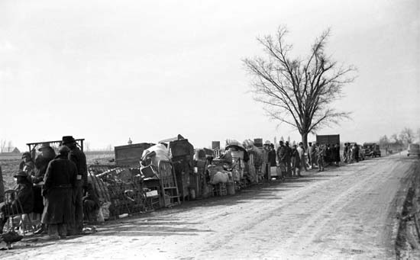

Slide 12
The Dust Bowl
Drought had begun in early 1930 in the Great Plains States
Texas Colorado
Oklahoma Wyoming
Kansas Montana
Nebraska New Mexico
South Dakota North Dakota
The land had been exhausted due to heavy farming and no top soil was left

Slide 13
The Dust Bowl
Windstorms would rip up whatever soil was left and scatter it eastward
1934
One storm moved dust from Kansas to New York City
The region that was the hardest hit was known as the Dust Bowl
Kansas, Oklahoma, Texas, New Mexico, Colorado

Slide 14
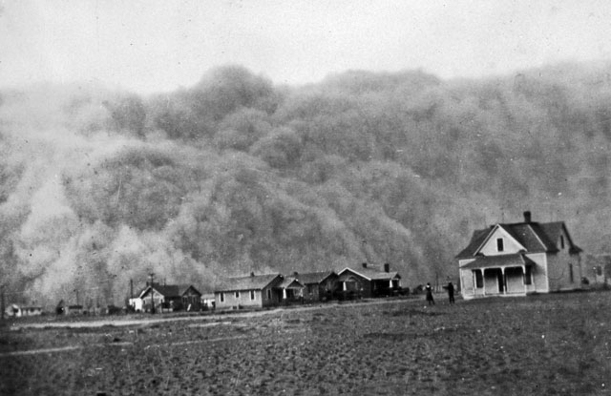

Slide 15
Dusts Bowl Migration
Plagued by dust storms and eviction notices, farmers leave their land behind
Many headed west following Route 66
Okies-
Farmers who came from Oklahoma and moved to California during the Dust Bowl
By 1932
Over 200,000 people migrated to California and other Pacific Coast states

Slide 16
Effects on the American Family
Many families stayed close to home to save money
Played monopoly (1933)
Listened to the radio
Men had a difficult time dealing with unemployment
Left families and became ‘hoboes’
Hitched rides across the US and lived homeless

Slide 17
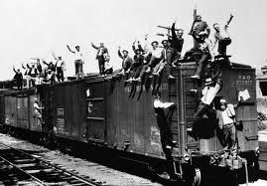

Slide 18
Government Role During the Great Depression
At the beginning there was no direct relief from the government
No cash payments or food provided by the government to the poor
Some charities offered relief but it was too little many times
Haven of Rest
Red Cross

Slide 19
Women Struggle to Survive
Women worked hard to help family
Canned food
Sewed clothes
Managed household budgets
Worked outside the home
Were looked upon by many men
Felt women were stealing jobs

Slide 20
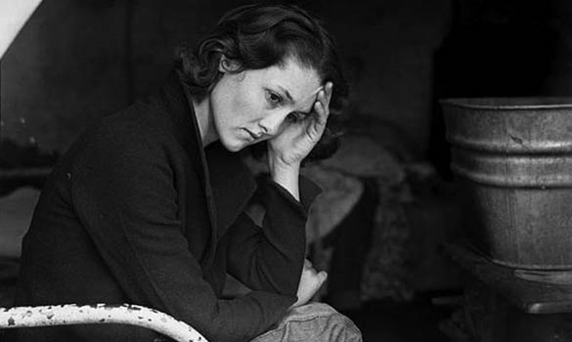
Social and Psychological Effects
1928 – 1932
Suicide rates rose more than 30%
Married men rose to 21%
People who admitted themselves to mental hospitals rose 300%

