Slide 1
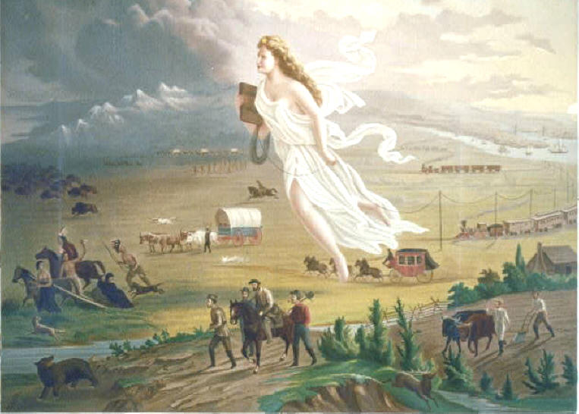

Slide 2
Manifest Destiny

Slide 3
Manifest Destiny
Ohio Standard:
Describe and analyze the territorial expansion of the United Sates and the Westward movement including Manifest Destiny

Slide 4
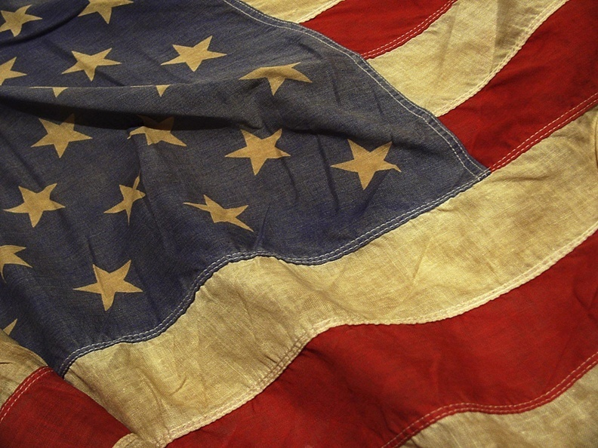
Manifest Destiny
The Belief that it was God’s will for the United States to Expand from the Atlantic to the Pacific Oceans (Popular in 1840s)

Slide 5
Where does this belief come from?
Puritan Colonist believed that God had given North America to them so they could set up a new ideal society
American Revolution proved to many that America was special and should be used to prove that democracy could function in a large society

Slide 6
Where does this belief come from?
Political leaders such as Jefferson and Madison believed that more land would prevent social tensions caused by growing cities in the East

Slide 7
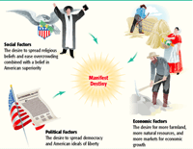
Manifest Destiny
The Belief that it was God’s will for the United States to Expand from the Atlantic to the Pacific Oceans (Popular in 1840s)
Why-
To Spread Democracy
Spread Christianity
Provide room to grow

Slide 8
Manifest Destiny
Becomes a driving force in Americas quest for new land and the desire to settle North America from the Atlantic to the Pacific

Slide 9
Presidential Election of 1844
Create a campaign poster, pamphlet, or advertisement for one of the candidates for president in the Election of 1844
Must Include:
Year of the Election
Candidate’s Name
Candidate’s Party
Candidate’s Qualification(s)
Candidates position on Manifest Destiny
Color, Neatness and pride in product will be included in your grade for this assignment.

