Slide 1
Manifest Destiny
Moving Into The Far West

Slide 2
Ohio Standards
Describe and analyze the territorial expansion of the United States including Manifest Destiny and the Mexican-American War

Slide 3
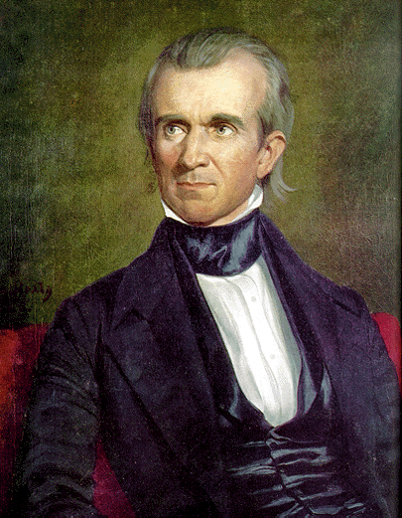
James K. Polk
Polk runs for election on a platform supporting expansion of the US
Polk takes his election as a sign that America supports Manifest Destiny

Slide 4
Oregon
By 1844 the United States had more than 40,000 citizens living in Oregon
Uses this fact to convince Britain to divide Oregon
Border between U.S. and Canada set at 49 degrees North giving Southern half of Oregon to United States

Slide 5
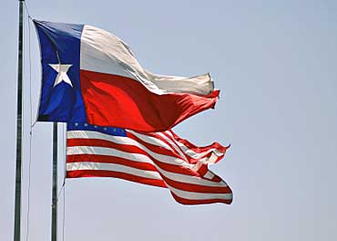
Texas
December 1844 U.S. agrees to annex Texas into Union as a slave state
Creates great tensions between the United States and Mexico

Slide 6
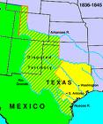
Border Dispute With Mexico
U.S. believes the southern border of Texas was the Rio Grande River
Mexico believes the southern border of Texas was the Nueces River
1,000 miles of disputed territory

Slide 7
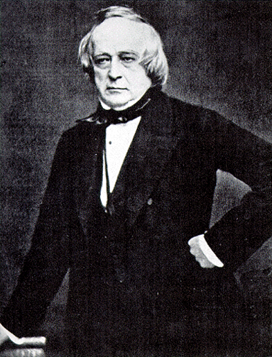
Border Dispute with Mexico
Polk send James Slidell to Mexico City to
Settle Border dispute with Mexico over Texas
Purchase Mexico’s northern provinces of New Mexico and California

Slide 8
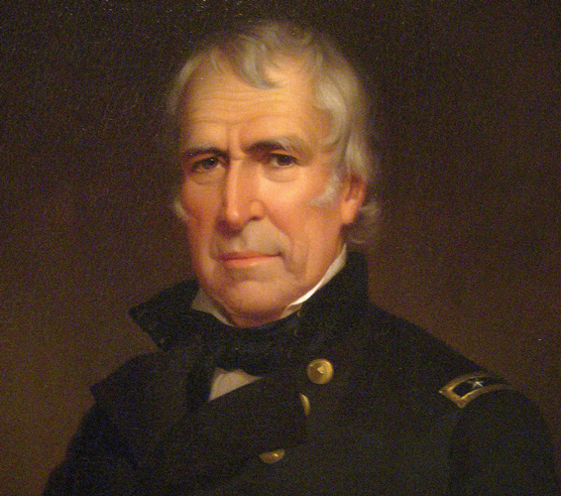
Polk Provokes War
Polk sends Zachary Taylor with an American army to patrol along the Rio Grande River

Slide 9
Congress Declares War
Mexican troops attack the U.S. Army along the Rio Grande
Polk explains how the U.S. Army was attacked on U.S. territory with out provocation
May 11, 1846 Congress declares war on Mexico

Slide 10
Mexican-American War
U.S. Victories in Northern Mexico
1
2

Slide 11
Mexican-American War

Slide 12
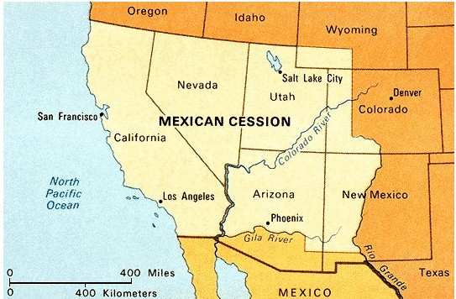
Treaty of Guadalupe Hildalgo
Signed February 1848
Southern boundary of Texas set at Rio Grande River
Mexican Cession ceded form Mexico to U.S

Slide 13
Treaty of Guadalupe Hidalgo
Signed February 1848
Southern boundary of Texas set at Rio Grande River
Mexican Cession ceded form Mexico to U.S
U.S. gives Mexico $15 million and assumes $3 million in Mexican debt

Slide 14
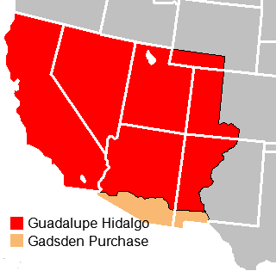
Gadsden Purchase
1853 U.S. purchased a narrow strip of land to build a rail road in the future

