Slide 1
Politics of the 1920s
The Republicans in power
(Pages 397 – 402)

Slide 2
The Election of 1920
Wilson’s idealism and Treaty of Versailles led to many Americans to vote for the Republican Warren Harding…
By end of term Harding would be known as a man
With poor judgment
Little ability to be a successful president

Slide 3
Republican Policies
Return to “normalcy”
Tariffs raised
Corporate and income taxes cut
Government spending cuts
Government-business cooperation
“The business of government , is business
Return to “Isolation”

Slide 4
Republican Fiscal Program
Republican economy supported Laissez Faire and big business……
Lower Taxes + Less Federal Spending + Higher Tariff = Strong US Economy

Slide 5
Harding Struggles for Peace
After WW I, problems surfaced relating to arms control, war debts, and the reconstruction of war torn Europe
1921, President Harding invited several powers to the Washington Naval Conference
Russia was left out because of its Communist government
Secretary of State Charles Evans Hughes urged that no more warships be built for 10 years
Also urged the US, Britain, Japan, France & Italy to scrap many of their largest warships
It worked for the 1st time in history powerful nations agree to disarm!!!

Slide 6
Kellogg-Briand Pact
1928 fifteen other countries signed the Kellogg-Briand Pact
This renounced war as a national policy
The problem was that the pact had no provisions on how to enforce it

Slide 7
High Tariffs and Reparations
Britain & France had difficulties repaying $10 billion they had borrowed from the US during the war
Eventually, there were 2 ways that were decided fair for repayment:
France and Britain could sell goods to the US
Collect reparations from Germany that were instilled on them by the Treaty of Versailles
Reparations are payments for war damages

Slide 8
How does selling goods to the US Pay us back?
1922 US adopted the Fordney-McCumber Tariff which raised taxes on US imports to 60% (THE HIGHEST LEVEL EVER)
Protects US business, but made it impossible for foreign companies to sell enough goods in the US to repay their debts

Slide 9
Reparations
What does Britain and France do?
They look to Germany for money
Germany couldn’t pay them because they had high inflation of their own
When Germany failed to make payment, French troops marched in

Slide 10
Reparations
To avoid another war, US banker Charles Dawes was sent to negotiate a loan
The Dawes Plan- American investors loan Germany $2.5 billion to payback Britain and France with annual payments
Those countries then paid back the US over time with their own money (plus interest)

Slide 11
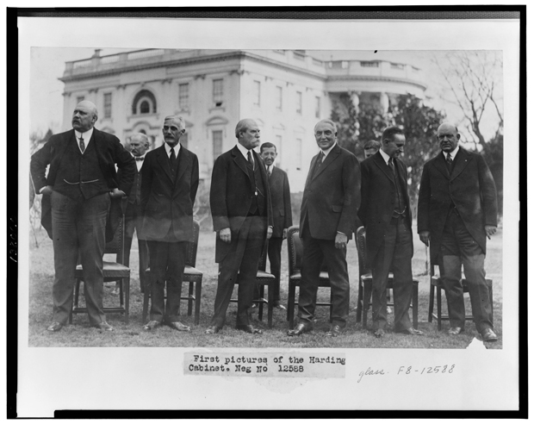
Scandal Hits Harding’s Administration
Things that went good:
Bureau of the Budget to help run the government more efficiently
He urged US Steel to abandon the 12 hour day (replaced with 8 hour day
Things that went bad:
Harding’s Cabinet

Slide 12
Harding’s Cabinet
Harding appointed Charles Evans Hughes as Secretary of State.
Eventually becomes Chief Justice of the Supreme Court
Harding made Herbert Hoover Secretary of Commerce
Did a great job distributing food and handling refugee problems during WWI
Andrew Mellon- one of the US wealthiest men became Sec. of the Treasury
Set about drastically cutting taxes and reducing the national debt

Slide 13
Ohio Gang
Hardy’s cabinet were literally Harding’s poker playing buddies
Leads to
Scandal!!!

Slide 14
Scandal During Hayes Administration
Harding’s main problem was that he didn’t understand the issues himself!
Publicly admitting this much to his cabinet
Since they knew this, they used their offices to make money with out Harding knowing about it
Most took bribe money
Charles R. Forbes- Head of the Veteran’s Bureau
Caught illegally selling government and hospital supplies to private companies

Slide 15
The Teapot Dome Scandal
Gov’t had set aside oil-rich public lands at Teapot Dome, Wyoming to use by the US Navy
Secretary of the Interior Albert Fall
Managed to get the oil reserves transferred from the navy to the Interior department
Then Fall secretly leased the land to 2 private oil companies
He received more than $400,000 in loans, bonds, and cash
First American to be convicted of a felony while holding a cabinet post

Slide 16
Harding’s Death
1923 President Harding died suddenly from a heart attack
Americans sincerely mourned their good natured president
Vice President Calvin Coolidge assumed the presidency

Slide 17
New Beginning
When Coolidge took over as president, he knew that some things had to change quickly
Crimes of the Harding Administration were coming to light when he took over
Helped to restore people’s faith in the government by fixing the problems quickly
Ran for election in 1924 and WON

