Slide 1
Post War Business in the US
Economic Boom (p 414 - 421)

Slide 2
The Business of America
Consumer goods fueled the business boom of the 1920s as America’s standard of living soared

Slide 3
American Industries Flourished
The new President, Calvin Coolidge, fit into the pro-business spirit of the 1920s. WHY?
Was a Republican who believed in keeping taxes down
Business profits up
Giving business more available credit in order to expand
Wanted to keep government interference in business to a minimum
Continued to place high tariffs on foreign imports
At the same time, wages and productivity were rising because of new technology

Slide 4
The Impact of the Automobile
Before the automobile, people were stuck traveling short distances unless they were close to a waterway
After the automobile , Americans could travel all over the country, but it wasn’t until the construction of paved roads that cars drove efficiently

Slide 5
Fords
1915 Model T
1928 Model A
The first mas produced automobiles to hit the American Market
Henry Ford developed his plant in Michigan and mass produced the auto “cheap enough so that every working man could afford one”

Slide 6
Route 66 (1926)
1916 Federal Road Act set up highway system
1926 Route 66 was paved from Chicago to LA
Travelers capable of quickly traveling across the country
Things quickly changed in the US
Citizens moved to areas between major cities developing their own neighborhoods
Yards got smaller as carports and driveways were being built
Gasoline stations popped up all to meet demand for it
New jobs opened in auto repair, public garages, motels, tourist camps and shopping centers

Slide 7
Traveling across America
Pre-1926
Post- 1926

Slide 8
What also changed because of the Automobile
Rural families were no longer isolated from society
Families could vacation in new, exciting areas of the country
Workers could live farther from work, resulting in urban sprawl
The unplanned sprawl of cities around the country due to the development of paved roads an the automobile
Cities such as Akron found a new economic source in the auto industry
Others such as Detroit, Flint, and Pontiac, Michigan grew drastically because of the Automobile
By the late 1920s, 1 in 5 Americans owned a car

Slide 9
The Young Airplane Industry
1920- Airplane industry began as a mail carrying service for the US Post Office
1926 Charles Lindbergh and Amelia Earhart both make Trans-Atlantic flights
Promote cargo and commercial airlines
1927 Pan-American Airway made the first transatlantic passenger flights

Slide 10
America’s Standard of Living
Americans owned about 40% of the world’s wealth in the 1920s
- Average annual income rose from $705 to $1,238
- Made it easier to afford the latest electrical appliances
1900
1928
Writing and Washboard $5
Brushes and Broom $5
Mechanical sewing
machine $25
Washing Machine $150
Vacuum Cleaner $ 50
Electric Sewing
machine $ 60

Slide 11
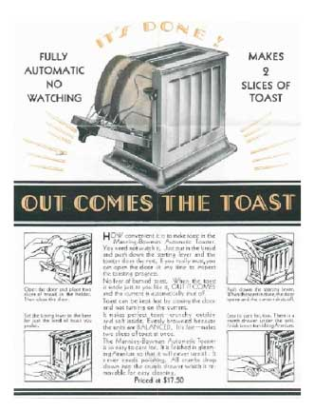
Electrical Conveniences
By the end of the 1920s more and more homes had electric irons, radios, cooking ranges, and toasters

Slide 12
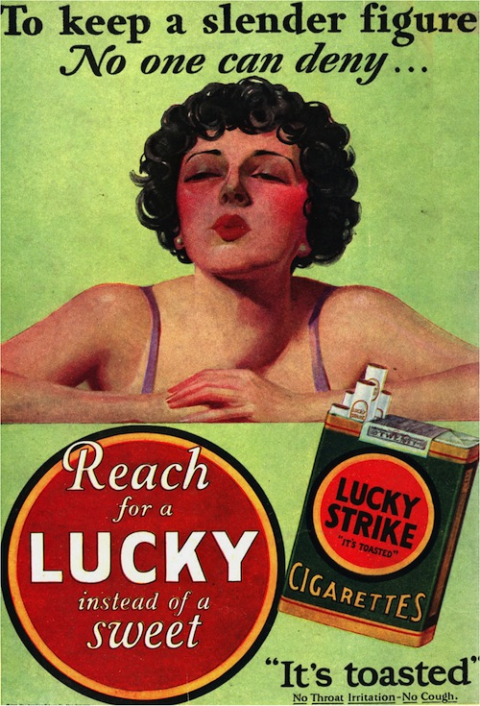
The Dawn of Modern Advertising
With new goods flooding the market, advertising agencies hired psychologists to study how to appeal to people’s economic desire.
Slogans were born:
“Say it with flowers”
Doubled flower sales between 1912 and 1924
“Reach for a Lucky instead of a sweet”
Lured weight-conscious Americans to cigarettes instead of candy

Slide 13
Superficial Prosperity of 1920s
Good
Bad
Average factory worker produced 50% mover at end of the decade than at the beginning
National income grew from $64 billion in 1921 to $87 billion in 1929
Stock market reaching new heights
Income gap between manager and worker widened
Iron and railroad industries were not prosperous thanks to the car
Farmers suffered losses now that European farmers were back in the market

Slide 14
Buying Goods on Credit
For those who didn’t have enough money, there was an easy fix:
Credit = “a dollar down and a dollar forever”
Also known as the installment plan
Enabled people to buy goods over an extended period of time without having to put much money down
Banks Provided money at low interest rates
Some economists worried that buying on credit might lead to a superficial economy that would become weak….
What could possible go wrong????

