Slide 1
Prosperity shattered
The Great Depression Begins
Pages 442 - 448

Slide 2
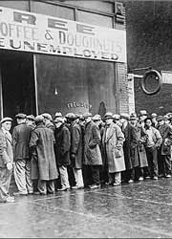
Prosperity Shattered
As the prosperity of the 1920s ended, severe economic problems gripped the nation

Slide 3
Economic Troubles on the Horizon
The 1920s issued some serious economic issues
Large divide between the rich and the poor
Important industries struggled
Farmers raised more crops than they could sell

Slide 4
Living on Credit
Many Americans looked prosperous during the 1920s
Wore new suits
Drove new cars
Had new appliances
How did they afford this?
Credit!!!!
Buy now! Pay Later!
Installment Plans offered monthly payments

Slide 5
Industries in trouble
Superficial prosperity of the 1920s hid weaknesses that would point towards the Great Depression
Key industries barely made profits
Railroads
Lost money to automobiles and buses
Coal mining, steel, and lumber
No longer in high demand by 1929

Slide 6
Farmers neeed a lift
WWI
Agricultural prices rose as international demand for crops grew steadily
Farmers planted huge amounts and took out loans for more land
Post WWI
Demand fell and so did crop prices
Farmers income declined by 60% by 1921
Lost their farms and farming equipment

Slide 7
Congress tries to help farmers
Passed the McNary-Haugen Bill
Called for price supports for key products such as Wheat, Corn, Cotton, and Tobacco
How does a price support work?
Gov’t will buy all surplus of crops at guaranteed prices and sell them on the world market
President Coolidge vetoed the bill twice and it was never put into effect
“Farmers have never made money. I don’t believe we can do much about it.”

Slide 8
Consumers have less money to spend
As farm income fell, they bought less goods and services
The Same was happening all over the country
Why?
Inflation
Prices were rising and wages were not
People overextended themselves on credit

Slide 9
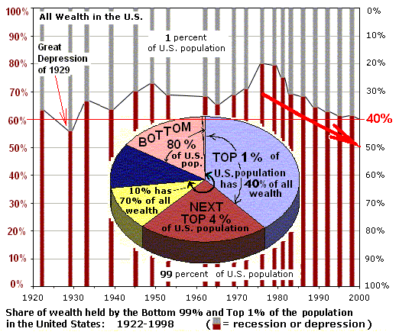

Slide 10
Uneven Distribution of Income
During the 1920’s
Rich got richer while the poor got poorer
More than 70% of American families earned less than $2,500 per year
Considered to be the minimum salary needed to live
Could not afford the luxuries of the 1920’s
1 in 5 homes owned a refrigerator
1 in 2 homes had electricity turned on

Slide 11
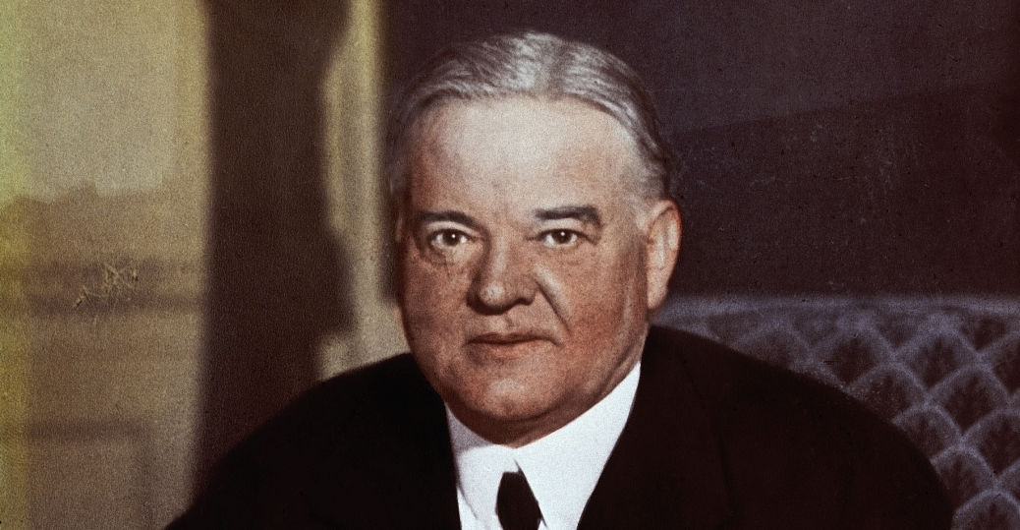
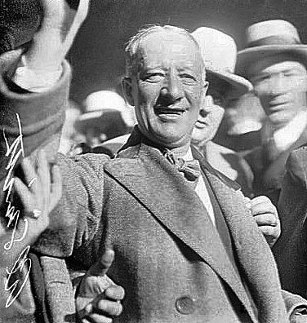
Election of 1928 Even with economic disaster around the corner, the election took place in a mood of prosperity
Herbert Hoover (Republican)
Secretary of Commerce from Iowa
Alfred E. Smith (Democrat)
Governor of New York

Slide 12
How does Hoover Win?
Alfred Smith was a Catholic
Conservative Americans feared that he would be an agent of the Pope
Hover had years of prosperity under his belt
Many Americans believed him when he spoke about the future of America
He stood for
Big business
Small town
Rural America

Slide 13
Dreams of Riches in the Stock Market
By 1929
Some economists had warned of economic weakness, but…
Americans bought into the stock market
Dow Jones Industrial Average was going up
A barometer used to measure market’s health
People were buying on speculation that stocks would continue to rise making a quick profit
Many bought on margin
Allowed them to pay a small percentage now and borrow the rest to purchase stocks

Slide 14
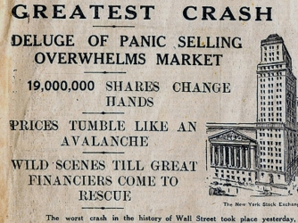
The Stock Market Crashes

