Slide 1
Articles of Confederation
America’s First Government

Slide 2
What do Americans want in a government?

Slide 3
Articles of Confederation
Creates a one branch government
Legislative Branch called Confederation Congress
No Executive Branch (To enforce laws)
No Judicial Branch (to Interpret Laws or settle disputes)
Enforcement and interpretation of laws left to the 13 states

Slide 4
Federal Powers under the Articles of Confederation
Federal Powers | State Powers
Request money from states | Tax
Coin money | Enforce federal law
Make treaties | Regulate commerce (Trade)
Create an army | Raise troops
Create a postal system | All powers given to Congress

Slide 5
What does Congress achieve under the Articles of Confederation?
Waged war for independence against Britain
Negotiated peace at the end of the American Revolution
Created a structure that encouraged states to recognize laws of other states
Organized lands west of the Appalachian Mountains for settlement

Slide 6
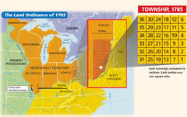
Land Ordinance 1785
Set up procedures for the surveying and sale of public lands in the Northwest Territory
(Lands north of the Ohio River)

Slide 7
Northwest Ordinance (1787)
Set up procedures to govern newly formed territories and to admit equal states to the nation.

