Slide 1
Transportation Innovation
The Growth of Railroads in the US

Slide 2
Rail Roads
Innovations in steel and oil industries lead to transportation improvements

Slide 3
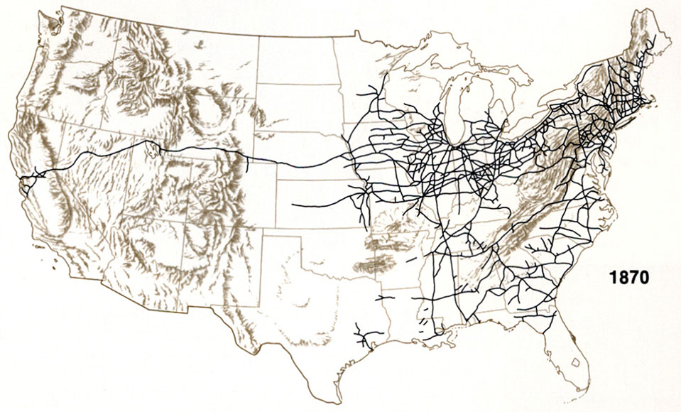
Rail Roads
Increased availability of steel causes steel prices to decrease
Railroad companies lay thousands of miles of track

Slide 4
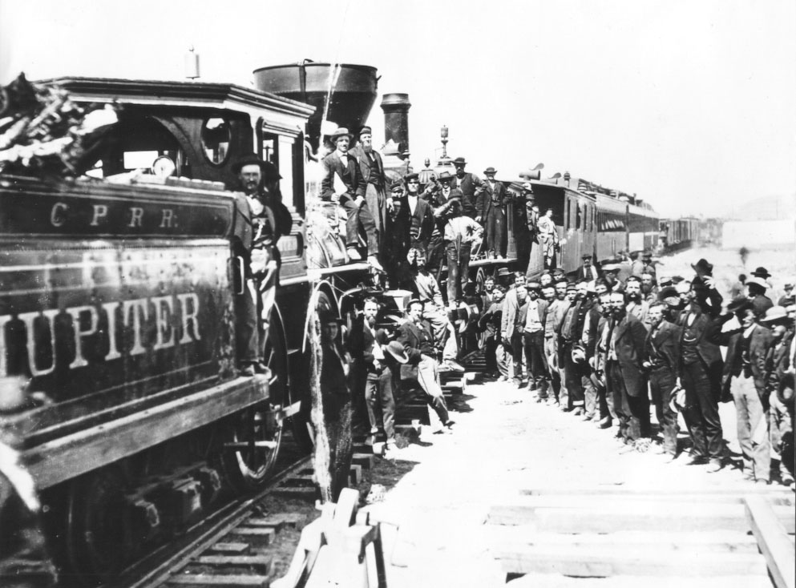
Effects of Railroad Expansion
More efficient rail networks
RR lines longer so fewer transfers necessary to ship people or goods long distance
1860 NY to Chicago took 17 transfers and 2 days
1870 NY to Chicago took no transfers and less than 24 hours

Slide 5
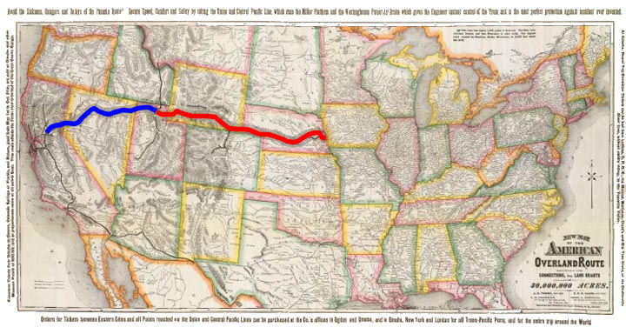
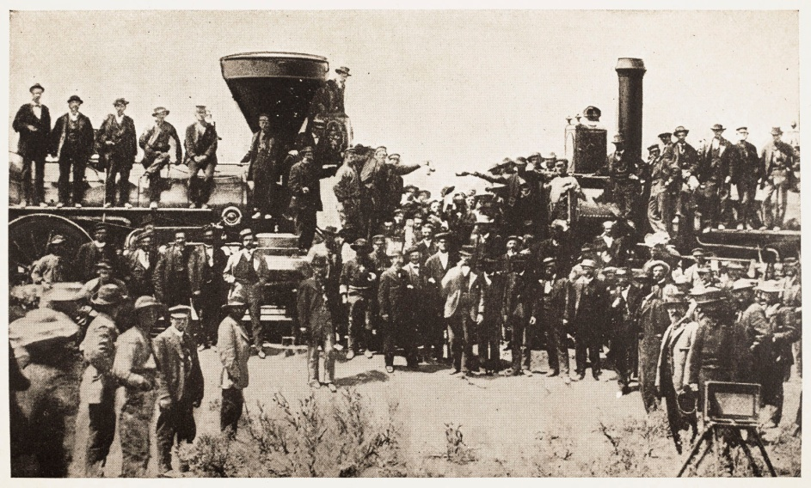
Transcontinental Railroad
Completed in 1869
By 1900 six major RR cross the Great Plains to the Pacific coast connecting all US states

Slide 6
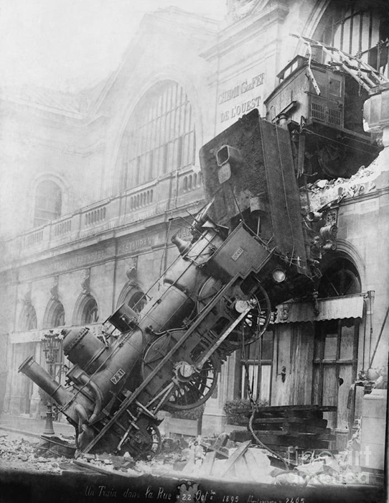
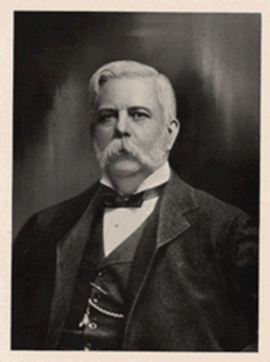
Other RR Improvements
Double Tracks
Larger Locomotives
Air Break by George Westinghouse

Slide 7
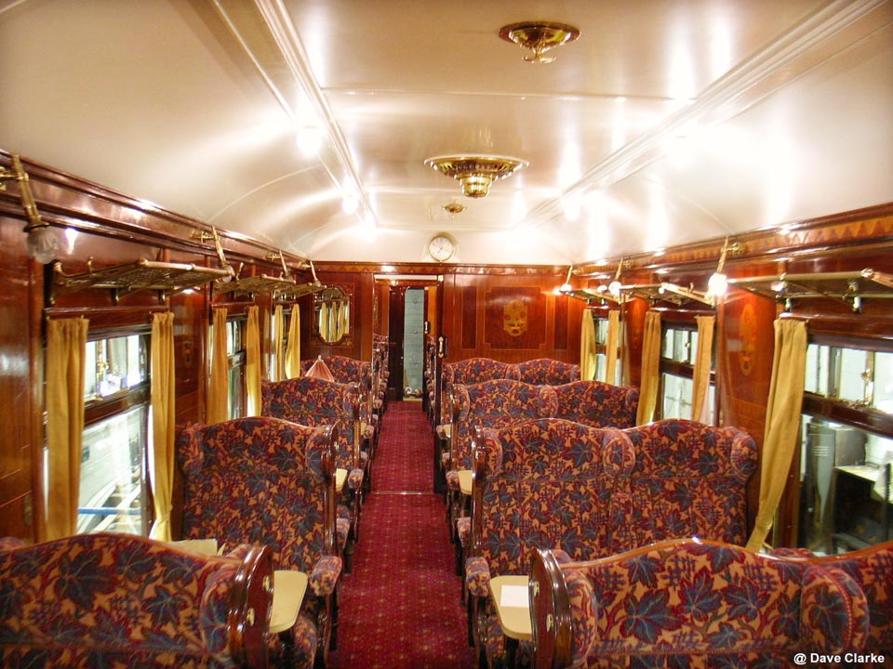
Effects of RR Improvements
Travel is more efficient
Americans have closer contact with one another
West grows in population
Urban areas grow

Slide 8
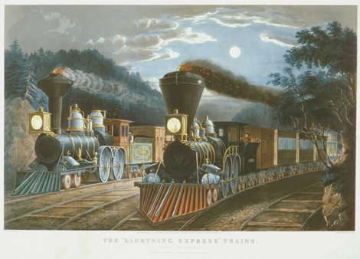
Economic Effects of RR Improvements
Jobs created in the RR industry
Jobs created in the steel industry
Nationalization of business

Slide 9
Questions of the Day
What development(s) led to railroad improvement in the late 19th century
Describe railroad developments that occurred during this time period?
What effects do railroad improvements have on the United States?

