Slide 1
World War I
U.S. Neutrality is tested

Slide 2
What did we learn yesterday?
4 causes of World War I
Two teams that fight against each other

Slide 3
America gets dragged into the war…
With the war causing great destruction in Europe, the US fights to remain neutral…

Slide 4
The Fight Starts
August 3, 1914
Germany invaded Belgium using Schlieffen Plan
Called for a holding action against Russia
Combined with a quick drive through Belgium to France
Once France had fallen, the 2 German armies would combine to defeat Russia

Slide 5
The Fight Continues
With Belgium lost, the Allies retreat to the Marne River in France
The German military gets stopped in Sept. 1914
By Spring 1915, both armies had dug in for trench warfare
Battles where armies fought for mere yards of ground in between two sets of trenches
In between the trenches would become known as “no man’s land”
A barren expanse of mud pockmarked with shell craters and filled with barbed wire

Slide 7
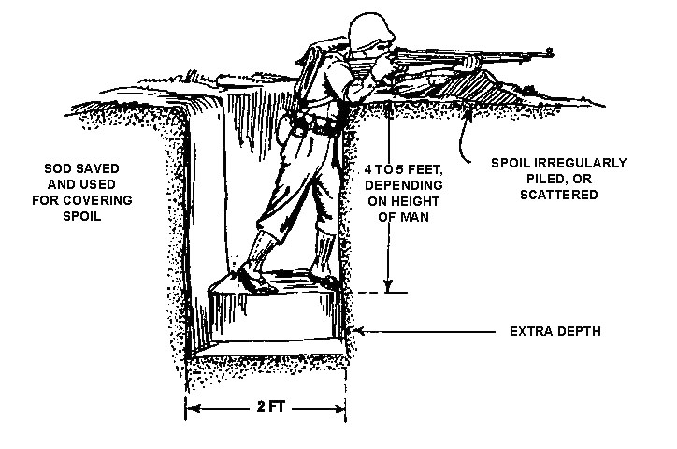

Slide 8
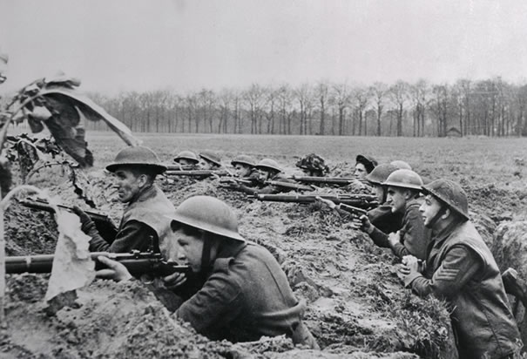

Slide 9
Trench Warfare
Continued for over 3 years with devastating and inconclusive results
(July – November 1916) Battle of Somme
British suffered 60,000 casualties the first day alone
Final Casualties = 1.2 million
Only to gain 7 miles

Slide 10
America Questions Their Neutrality
Socialists
Criticized the war as a capitalistic and imperialist struggle between Germany and England to control markets
Pacifists
Led by William Jennings Bryan
Believed the war was evil and that the US should set an example of peace
German and Irish Americans
Favored Germany
Irish Americans hoped that if Germany won, it would provide a chance for them to gain independence from Britain

Slide 11
The War Hits Home
The majority of American favored victory for the Allies rather than the Central Powers, BUT
we did not want to join the war
By 1917, America begins to build its military
Mobilization occurs for two reason
To ensure Allied repayment for debts to the US
To prevent Germans from threatening US shipping

Slide 12
Britain tries to Starve Germany
British Blockade
The use of naval ships to block off areas of water
Originally intended by Britain to blockade only the coastline of Germany
Prevent weapons and other military supplies from getting to Germany
Eventually, they include food as contraband

Slide 13
Results of the British Blockade
Results were 2 fold
US ships carrying goods for Germany refused to challenge the blockade
Germany found it difficult to import food and fertilizers for crops
Germany suffered severe famine
750,000 Germans starve to death

Slide 14
German U-Boat Response
Germany used a counter blockade with U-Boats
Submarines
German orders were to sink any British or Allied ship found in the waters around Britain
Germany warned US in newspapers against traveling on British ships into a war zone
President Wilson argued that it was our right to travel anywhere we want

Slide 15
German Counterblockade

Slide 16
Sinking of the Lusitania
May 7, 1915
German U-boats sink the British liner Lusitania off the Southern coast of Ireland
Of 1,198 casualties, 128 were Americans

Slide 17
U-boats strike again…
August 1915
Germany agrees to restrict U-boat attacks under sharp protest from America
March 1916
Germany breaks its promise with the US
Torpedoes a French passanger ship named the Sussex
Kills 275 people
Germany signs the Susex pledge
Germany agrees to restrict U-boat attacks only if Britain lifts the blockade against food

Slide 18
1916 Election
November 1916
The US presidential election between
Woodrow Wilson (D)
Runs on “He kept us out of the war “ slogan
Charles Hughes (R)
Pledged to uphold America’s right to freedom on the high seas
Wilson wins by a narrow margin

Slide 19
Peace without Victory
After election, Wilson tried to mediate between the warring alliances
(1917) In a speech to Congress, the president calls for “a peace without victory… a peace between equals”.
Idea= to have the war end without either side imposing harsh terms on the other.
Germany, France, or Britain did not want this because they did not want millions of their countrymen to die in vain

Slide 20
German Reaction
January 31, 1917
Germany declares that U-boats will sink all ships in British waters on sight.
Again, Wilson tried to keep the US out
“We will wait for actual overt acts before declaring war”
The Zimmerman Note was found
A telegram from Germany to Mexico proposing Mexico aid Germany by attacking USA
IF the US joined the war, then Germany would support Mexico re-gain “lost territory in Texas, New Mexico, and Arizona

Slide 21
Zimmerman Telegram

Slide 22
In Russia
March 1917
Revolutionaries ousted Czar Nicholas II oppressive regime
Established a provisional democratic government
Now supporters of American entry into war could claim that this war was of democracies against brutal monarchies
Part of the Bolshevik Revolution
April 1917
Motivated by Russia, Wilson delivers a speech to Congress
America is needed to help make world “safe for democracy”
We declare war against Central Powers on April 2, 1917

