Slide 1
Jamestown
England First Colony Becomes Successful

Slide 2
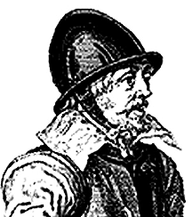
Jamestown
John Rolfe
Introduces Caribbean Tobacco in 1612

Slide 3
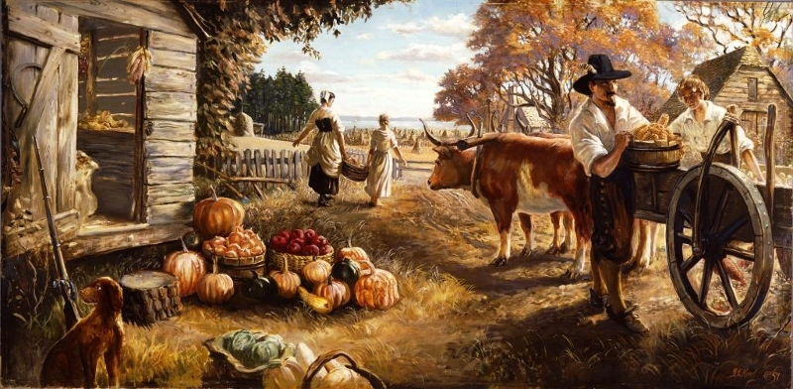
Jamestown
Need to attract settlers to grow tobacco
Headright System: The granting of 50 acres of land for each person’s paid passage to VA

Slide 4
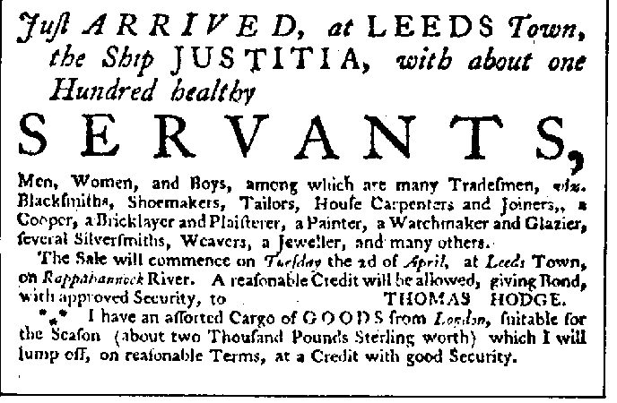
Jamestown
Need to attract labor
Indenture- colonist that sign a contract to work for person that paid passage to VA for a period of 4 – 7 years

Slide 5
Bacon’s Rebellion
Who:
What
When:
Why:
Resulting In:

Slide 6
Jamestown
Slaves
1st Africans arrived on Dutch ship in 1619 and worked as indentured servants
African slaves begin to replace indentured servants
What economic advantage(s) would slaves have over indentured servants?

