Slide 1
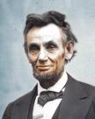
A Tragic Conclusion

Slide 2
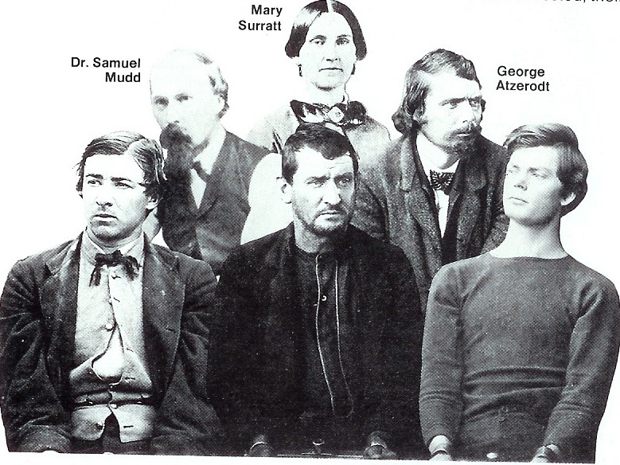
A Tragic Conclusion
1864 Conspiracy to KIDNAP President Lincoln
Plot created by John Wilkes Booth
Help from David Herold, George Atzerot, Lewis Powell, Edman Spangler, & Mary Surratt

Slide 3
A Tragic Conclusion
Kidnap attempt failed March 17, 1865
New Plan after Appomattox Court House
Powell to kill Sec. State Seward
Atzerodt to kill Vice President Johnson
Booth to kill President Lincoln

Slide 4
A Tragic Conclusion
Only Booth succeeds

Slide 5
A Tragic Conclusion
All Conspirators convicted on June 29, 1865
Atzerodt, Herold, Powell, Surratt hanged (July 7, 1865)

Slide 6
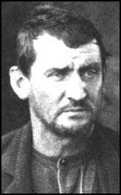
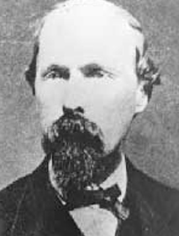
Tragic Conclusion
Dr. Mudd and Spangler sentenced to life in prison.

Slide 7
Tragic Conclusion
How will this effect Reconstruction?

Slide 8
Johnson’s Plan
Amnesty to all southerners who took an oath of loyalty
Wealthy southerners and former Confederate officials need presidential pardon to qualify for amnesty

Slide 9
Johnson’s Reconstruction
Re-admittance of southern states
President appoints temporary governor
Southerners that have taken an oath of loyalty elect delegates to revise their state constitutions
Voters elect representatives to US Congress
Gov’t must declare secession illegal
Refuse to pay Confederate debts

Slide 10
Johnson’s Reconstruction
All states re-admitted under Lincoln’s 10% plan remain in place
By the end of 1865 all former CSA states all states except Texas re-admitted

Slide 11
Congress
Congress refuses to accept representatives from reconstructed states
What does this indicate about Reconstruction?

