Slide 1
#6- The Birth of Political Parties
Chapter 10 Section 5

Slide 2
The Birth Of Political Parties
Political Party- A group of people that have similar beliefs about how the government should be run

Slide 3
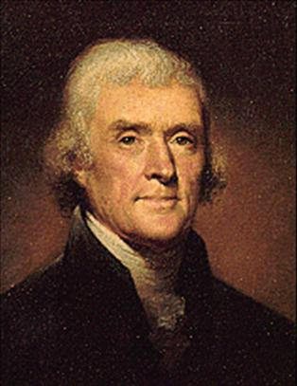
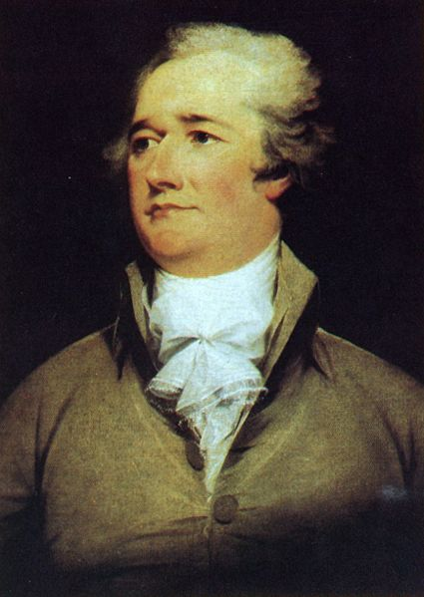
Birth of Political Parties
American political parties developed during the Washington administration
Developed out of disagreements between Alexander Hamilton and Thomas Jefferson over the direction of America and its government

Slide 4
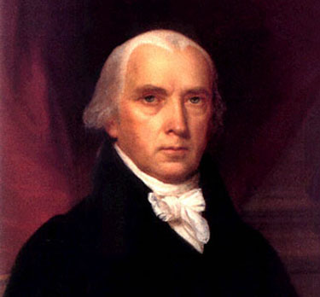
Birth of Political Parties
Federalist Party
Started by Alexander Hamilton
Democratic-Republicans
Sometimes called Republicans
Started by Thomas Jefferson and James Madison

Slide 5
Supporters of the Parties
Federalists supported by-
Manufacturers
Business People
Creditors
People of upper economic class

Slide 6
Supporters of the Parties
Democratic-Republicans supported by
Farmers
Planters
Debtors
Laborers
People of lower economic class

Slide 7
Ideas About the Government
Federalist-
Strong centralized government
Loose construction of Constitution
Gov’t lead by educated elite
Democratic-Republicans
Decentralized government (States’ Rights)
Strict construction of Constitution
Gov’t lead by common man

Slide 8
Domestic Policy
Federalist
Favored the Bank of the United States
High (Protective) Tariffs
Democratic Republicans
Opposed the Bank of the United States
Low (Revenue) Tariffs
Few (if any) domestic taxes

Slide 9
Foreign Policy
Federalists-
Oppose French Revolution
Want to side with English in French Revolution
Democratic-Republicans
Support French Revolution
Want to assist the French Republic

Slide 10
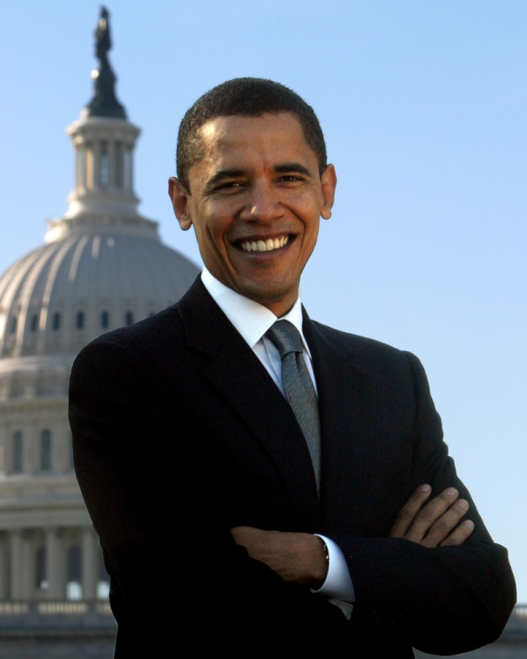
Modern Political Parties
Primary Job
Get candidates elected into office

Slide 11
Modern Political Parties
Secondary Jobs
Provide qualified candidates for political jobs
Limit the number of candidates running for each office
Draw up platforms
Pay for campaigns
Inform voters
Watchdog
Provide communication between voters and the gov’t.

