Slide 1
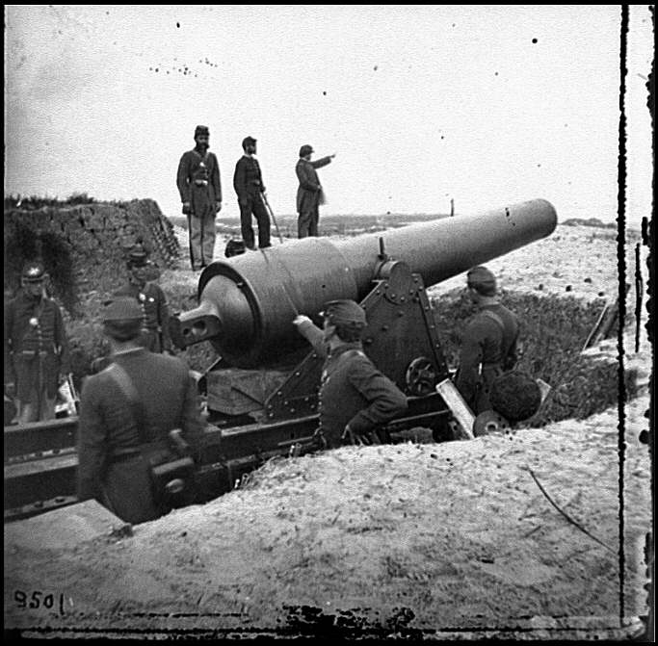
Civil War Strategies

Slide 2
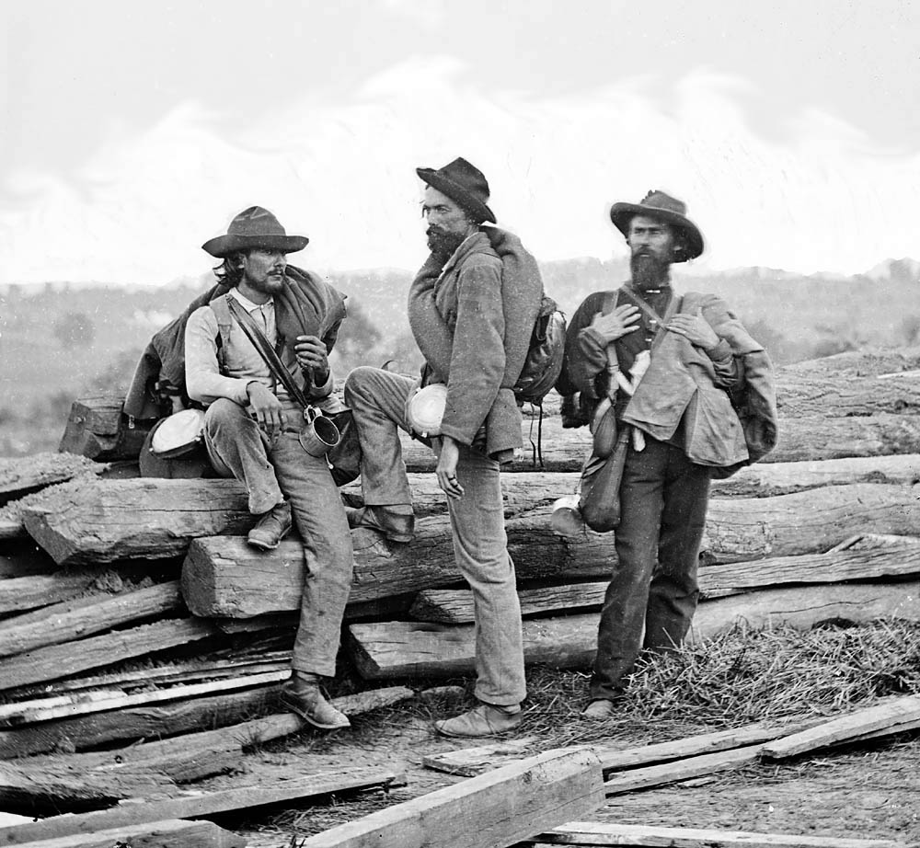
The Strategy of the C.S.A.
Conduct Cotton Diplomacy
Sell cotton to Great Britain to finance the war and to coerce Great Britain to become an ally
Fight a defensive war to outlast the Union’s will to fight

Slide 3
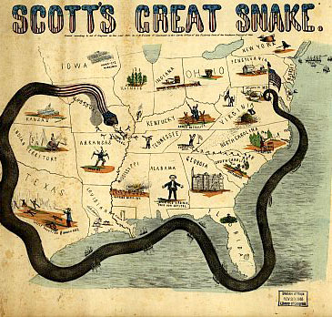
Union Strategy
Called the Anaconda Plan
Blockade all Confederate ports
Cut the far western states from the east by capturing the Mississippi River
Cut the states between the Appalachian Mts. and the Mississippi River in half by controlling the Cumberland and Tennessee Rivers
Capture Richmond, Virginia

Slide 4
Theaters of War
Two theaters of war
Eastern Theater
Fought on land east of the Appalachian Mountains
Fighting to control land between Washington, D.C. and Richmond, Virginia
Northern Army called Army of the Potomac under the leadership of Gen. George B. McClellan responsible for defending Washington, D.C.
Southern Army called Army of Northern Virginia under the leadership of Gen. Robert E. Lee responsible for defending Richmond.

Slide 5
Theaters of War
Western Theater-
Battles fought west of the Appalachian Mts.
Union Army of the Ohio led by Don Carlos Buell and U.S. Grant in charge of controlling the Mississippi River
Southern Armies led by Albert Sidney Johnston in charge of defending the West

