Slide 1
Colonies After French and Indian War
Troubles on the Frontier

Slide 2
Class Goals
I can
Identify point of view after reading a quote
Explain the relationship between the Native Americans and the English colonists after the French and Indian War

Slide 3
Trouble on the Frontier
“Englishmen, although you have conquered the French, you have not yet conquered us”- Minavavana (leader of Chippewa)

Slide 4
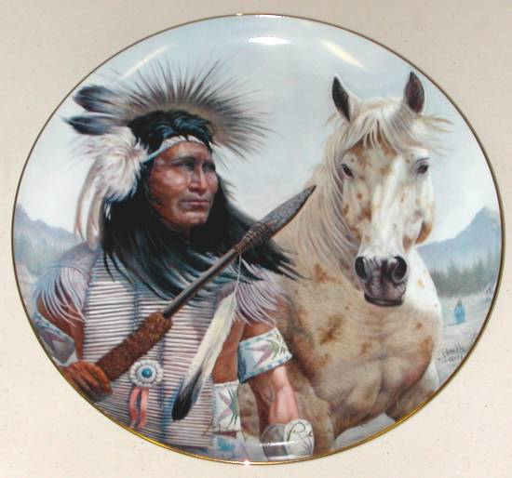
Chief Pontiac
“How comes it that you suffer the whites on your lands? Can’t you do without them? You might live wholly as you did before you knew them… those who came to trouble your country, drive them out, make war on them!... They are my enemies and the enemies of your brothers”

Slide 5
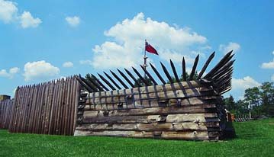
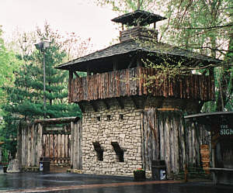
Pontiac’s Rebellion
Pontiac organizes Delaware, Huron,
Miami, Ottawa, and Shawnee
Attack and capture 7 British forts
on the frontier
His alliance is unable to capture
Forts Pitt and Detroit which causes
the alliance to fall apart in 1766

Slide 6
Troubles on the frontier
British officials fear that continued frontier fighting would disrupt trade and cost the empire much money.
If you were the British, how would you solve the troubles on the frontier?

Slide 7
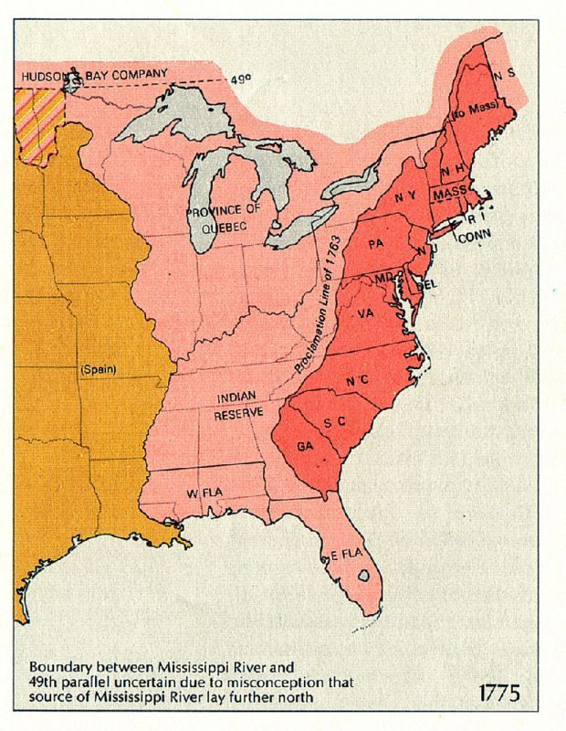
Proclamation Act 1763
Passed by British Parliament
Banned the British from settling west of the Appalachian Mountains
Orders all colonist living in the upper Ohio Valley to move east

Slide 8
Proclamation of 1763
How would you react if you were a British colonist ?

