Slide 1
French and Indian War
P 161 – 162 Call to Freedom

Slide 2
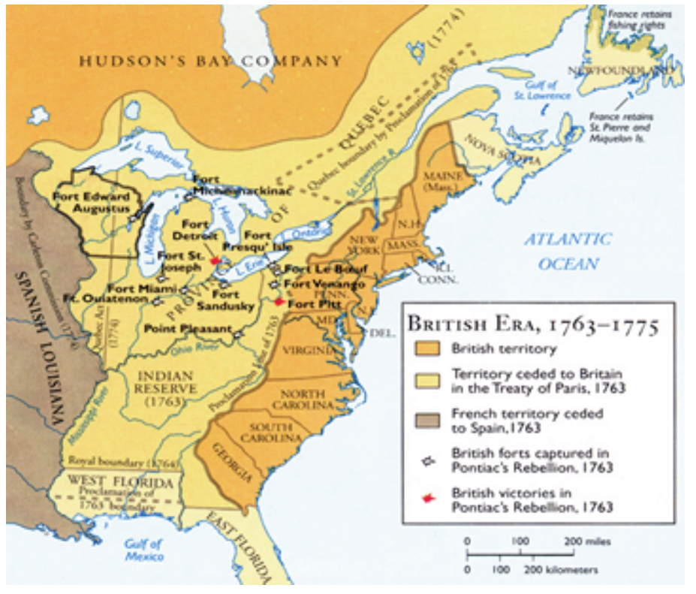
Cause of the War
Both Britain and French had claim to the OH River Valley
Both Nations trading furs with Native Americans

Slide 3
Causes of the War
Britain Builds trading posts in OH Valley and begins to sell land to be used for settlements and farms
France attacks trading posts

Slide 4
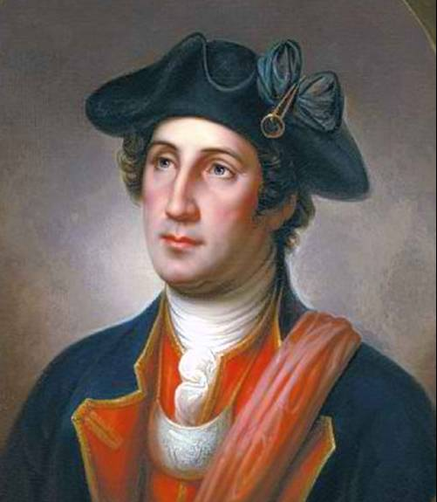
Start of WAr
Virginia sends a militia led by George Washington to inform the French to leave the valley
French politely refuses to leave

Slide 5
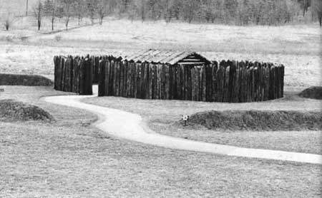
Start of War
Washington and his men attack French Fort Duquesne (present day Pittsburg) and looses
Then Washington Responds by building Fort Necessity
French Attack Fort Necessity and force Washington to sign a surrender document

Slide 6
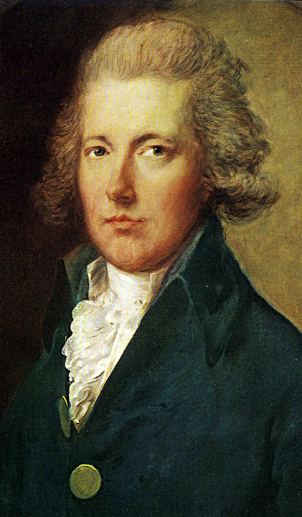
Pitt becomes leader of Britain
War continues to go poorly for the British during early years
William Pitt becomes leader of Great Britain
  England begins to win many battles
  Capture Louisbour, Quebec and Fort Duquesne
France Surrenders

Slide 7
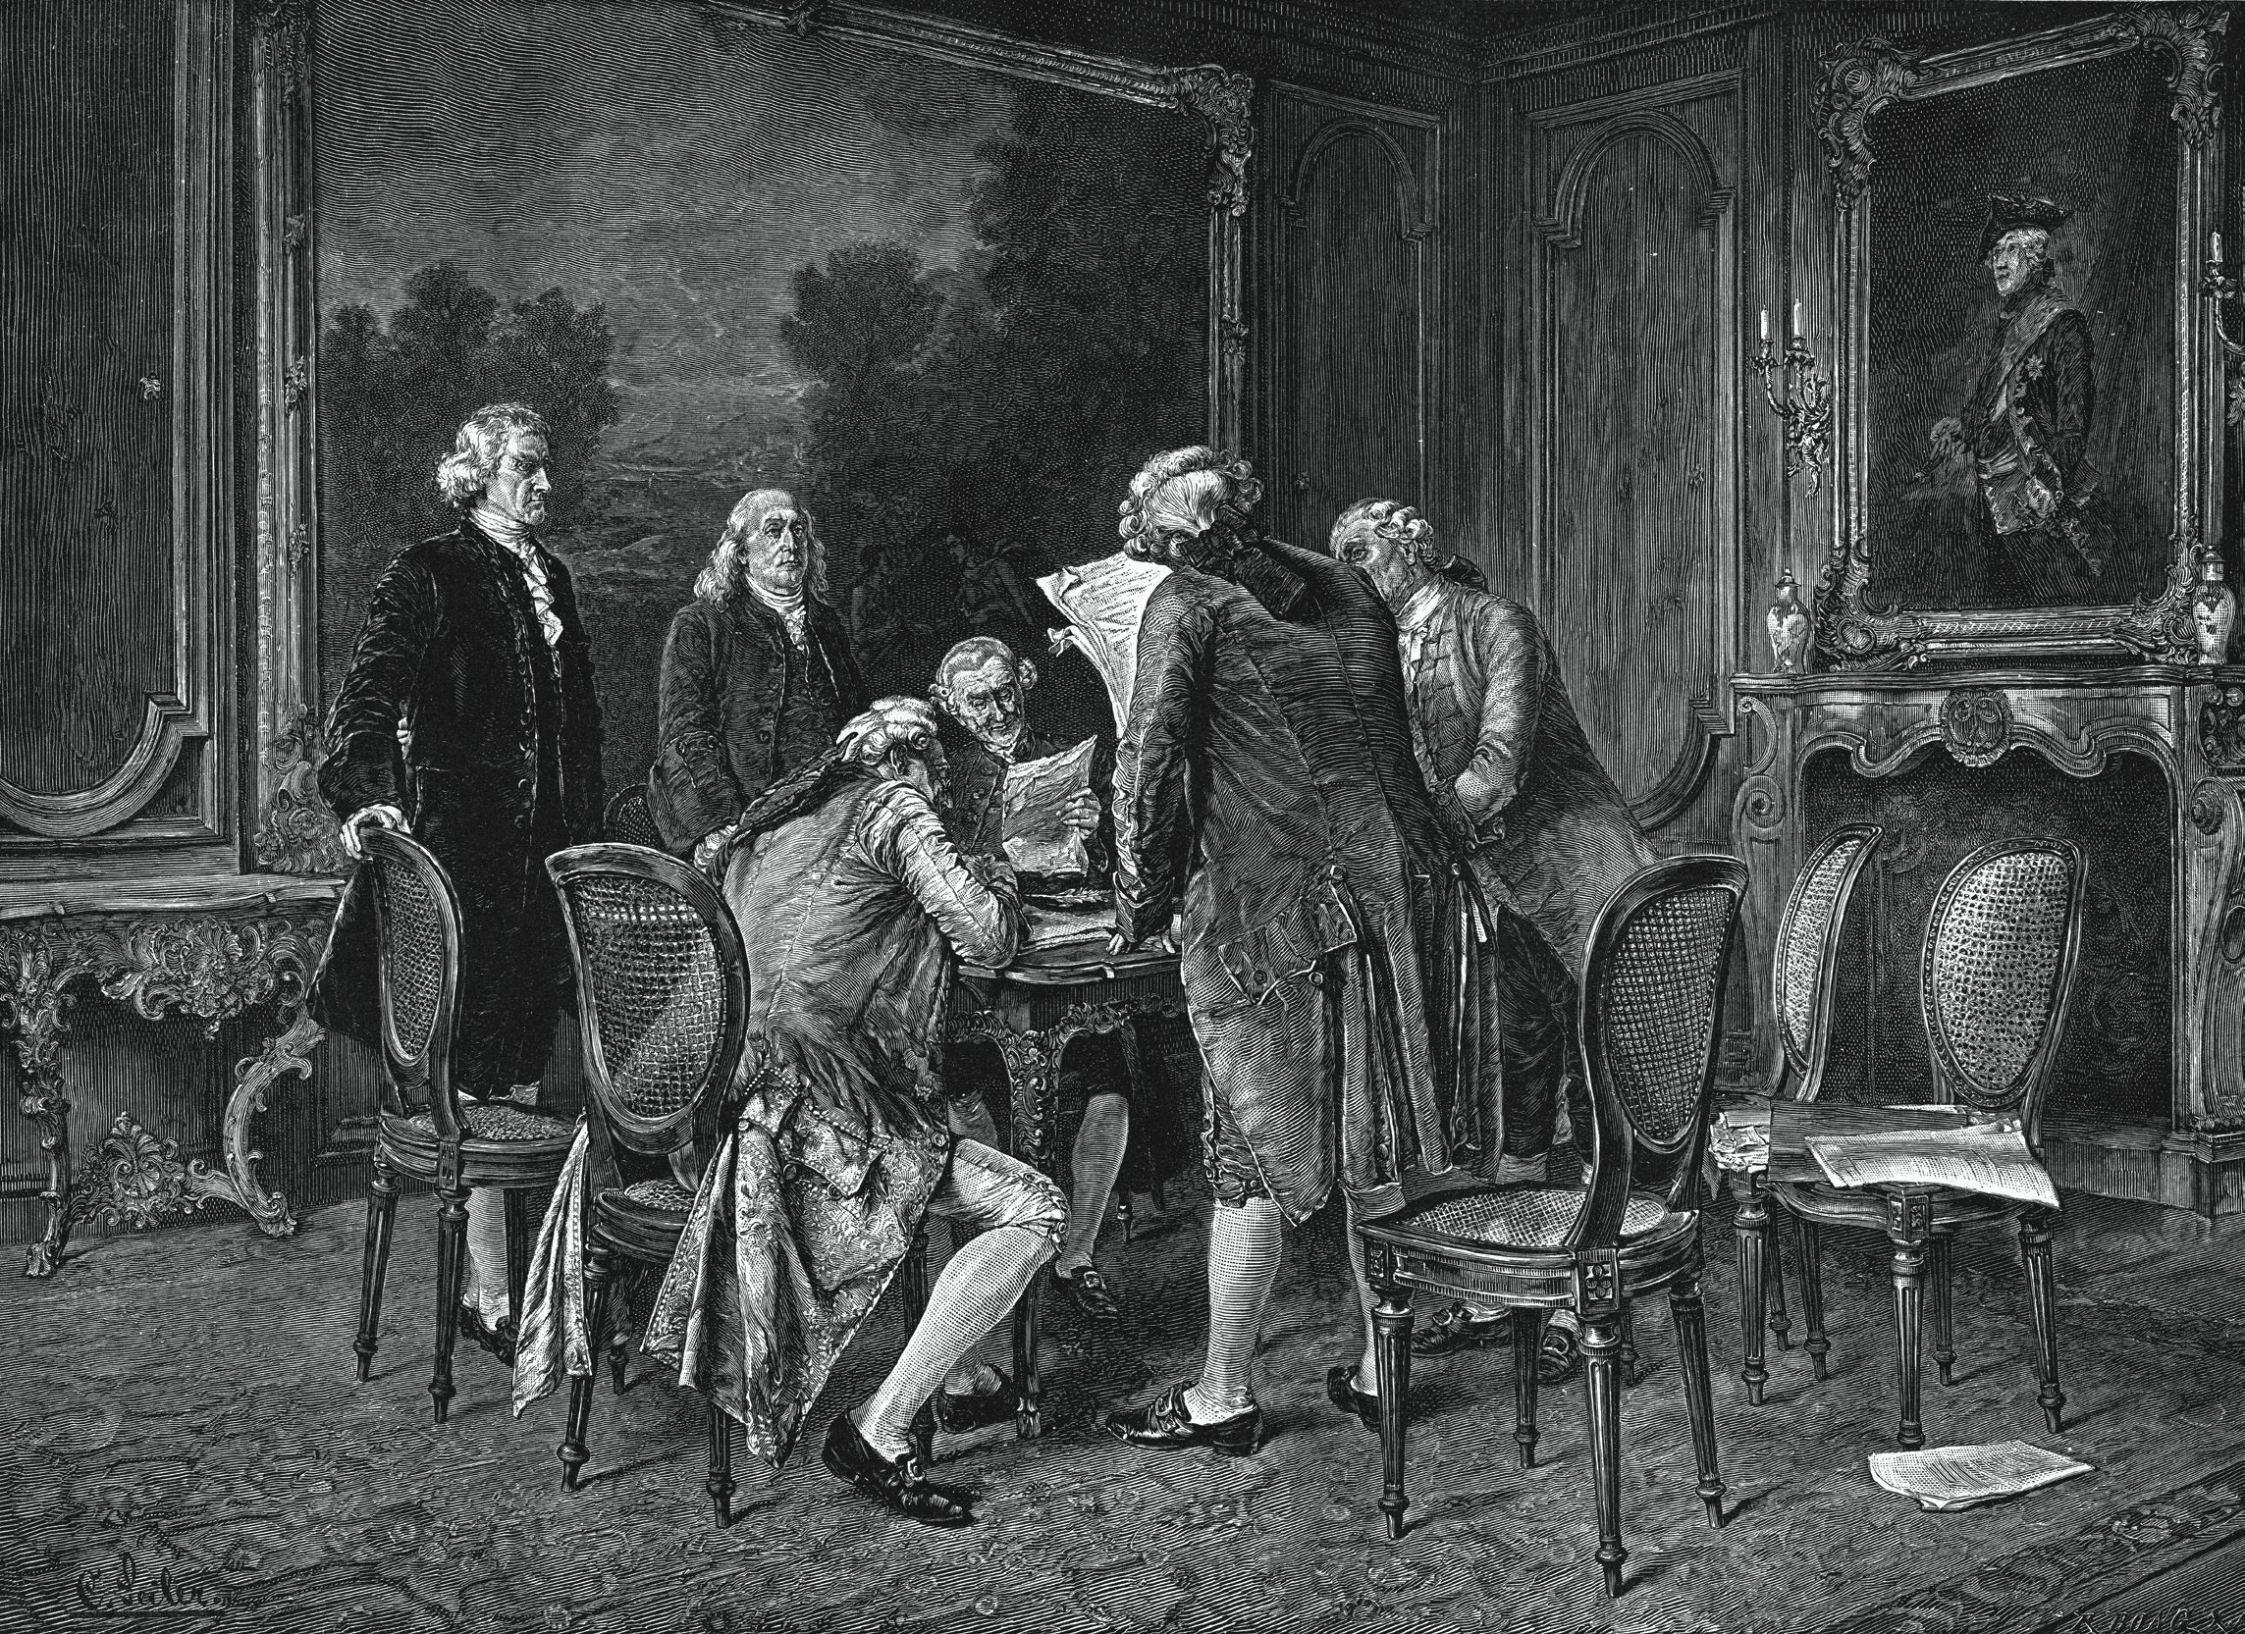
Treaty of Paris (1763)
All of Canada Given to Britain
French land East of Mississippi river given to Brittan
New Orleans and all land west of the Mississippi River given to Spain
Florida given to Britain

Slide 8
Effects of French and Indian War
French are effectively driven from North America
Colonists begin to have a sense of Unity (see selves as Americans as much as British)
Fighting between the British and the native Americans increases
British empire so large that Britain needs to find new ways to manage it

Slide 9
Essential Questions
Explain What caused the French and Indian war?
Describe the significance of the French and Indian war-

