Slide 1
Turning Point of the War
July 1863

Slide 2
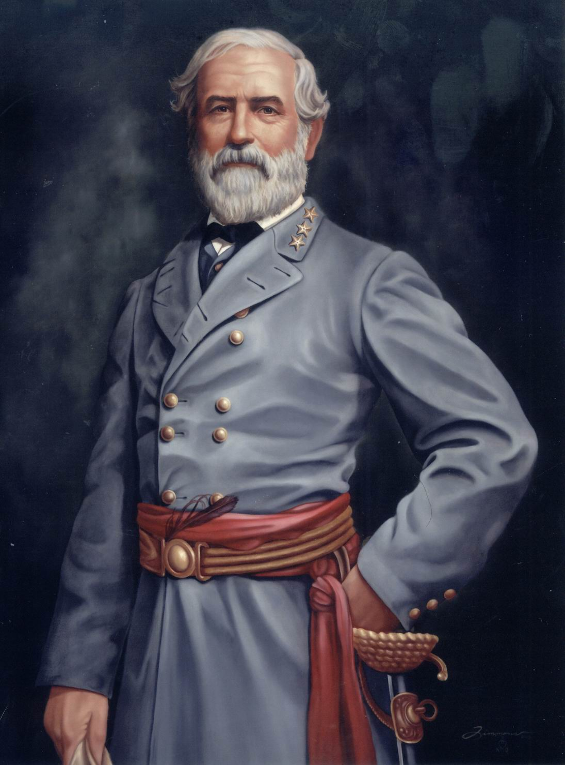
Lee Invades North for 2nd Time
1- Break the Union’s will to fight
2- Obtain needed supplies

Slide 3
Lee Invades North for 2nd Time
Marches 75,000 Confederate soldiers from Virginia cuts though Maryland to Pennsylvania

Slide 4
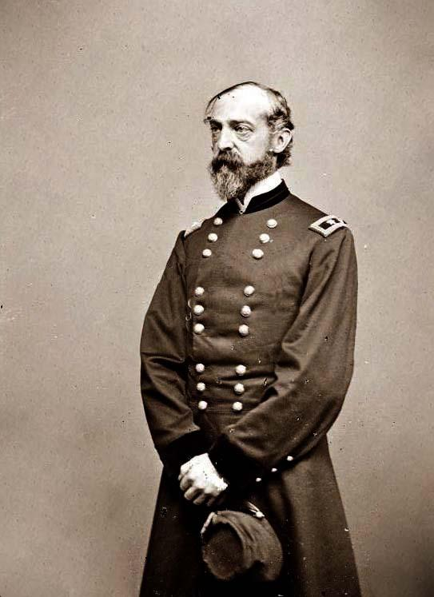
Battle of Gettysburg
General George B. Meade leads 90,000 Union troops onto Pennsylvania in pursuit of Lee’s army
The armies meet at Gettysburg, PA

Slide 5
Planning the Battle
How did the Union hope to defeat the confederacy?
Describe what Lee believed his best chances to win the battle were
Why didn’t Lee’s plan happen?

Slide 6
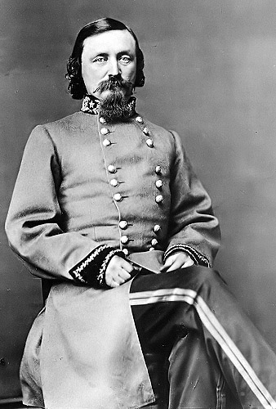
Pickett’s Charge
Confederate General leads 14,000 men in an attack on Union stronghold on Cemetery Ridge

Slide 7
Pickett’s Charge
Describe Pickett’s Charge

Slide 8
Effects of Gettysburg
What effect did the Battle of Gettysburg have on the Confederacy?
How did Lincoln respond to the Union Victory at Gettysburg?

Slide 9
Vicksburg
Why was Vicksburg an important town?
Which Union General was responsible for capturing Vicksburg?

Slide 10
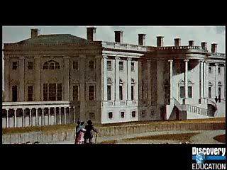
Vicksburg

Slide 11
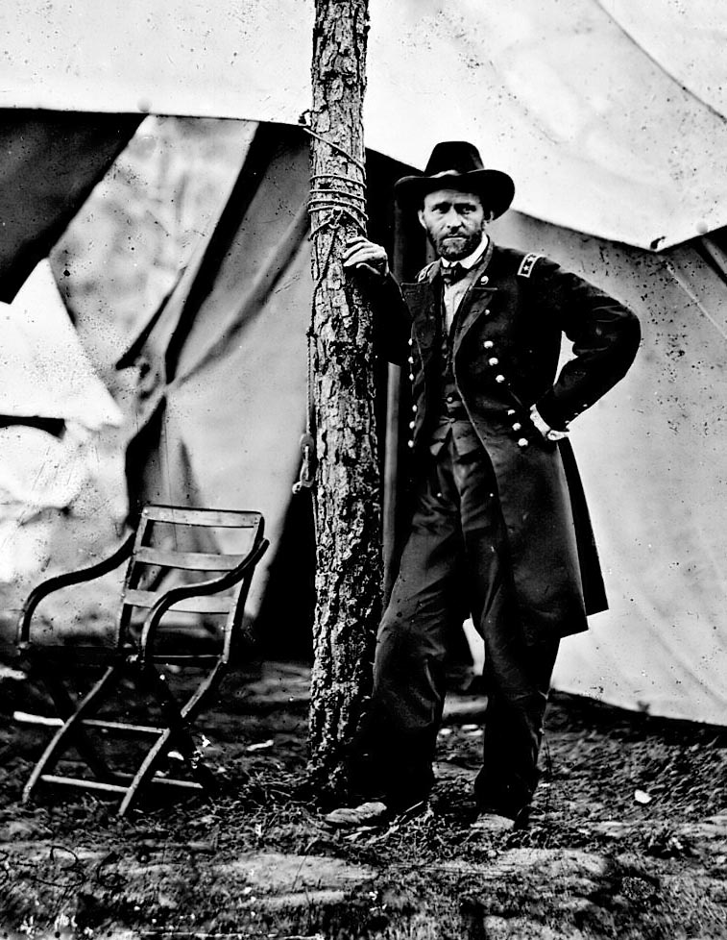
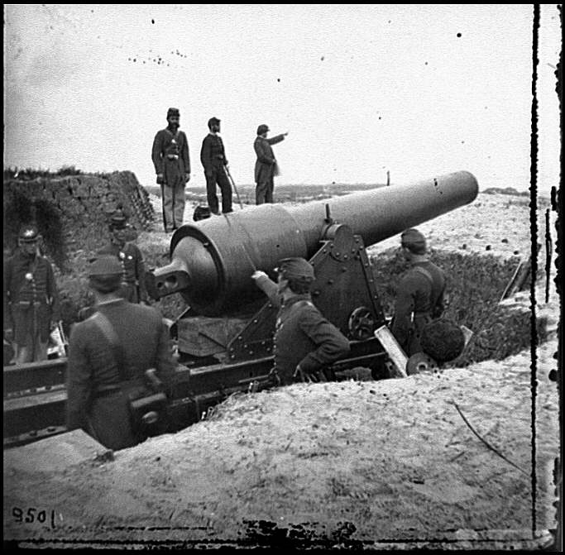
Fall of Vicksburg
After weeks of siege, the Union army under command of U.S. Grant captured Vicksburg on July 4, 1863

Slide 12
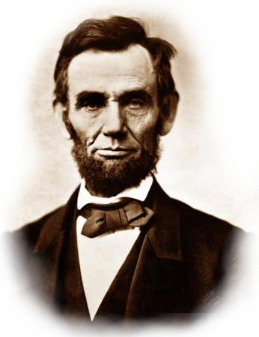
How will Lincoln Respond?

