Slide 1
Hoover Struggles with the Depression
Pages 456 - 463

Slide 2
President Hoover Struggles with the Depression
President Hoover’s conservative response to the Great Depression drew critcism from many Americans

Slide 3
Hoover Tries to Reassure the Nation
After the stock market crash in 1929, President Hoover tried to reassure Americans that the economy was on sound footing
“Any lack of confidence in the economic future… is foolish.”
-Herbert Hoover
In his view, Americans needed to stay optimistic

Slide 4
Government’s Role Under HoverThe
Republicans believed depressions are a normal part of the business cycle that follows a period of rapid economic growth
The best thing to do is to take the ‘laissez-faire’ approach
Hoover opposed any social welfare programs
Would weaken people’s self-respect and ‘moral fiber’
Believed Americans’ believed in rugged individualism
The idea that people should succeed through their own efforts

Slide 5
Hoover Takes Cautious Steps
Hoover’s political philosophy caused him to take caution:
At the time of the crash, he called business leaders together to work together to find solutions
Don’t cut wages or lay off people
Asked labor leaders not to ask for raises or go on strike
A year after the crash:
Economy still shrinking
Unemployment still rising

Slide 6
Boulder Dam
One project that Hoover approved did make a difference
(1929) Boulder Dam (Later named Hoover Dam) was built in Nevada
Cost over $700 million
Provided electricity to California, Colorado, Arizona, Utah, New Mexico, and Wyoming
Provided a constant water supply as well which enabled California to begin its massive agricultural growth

Slide 7
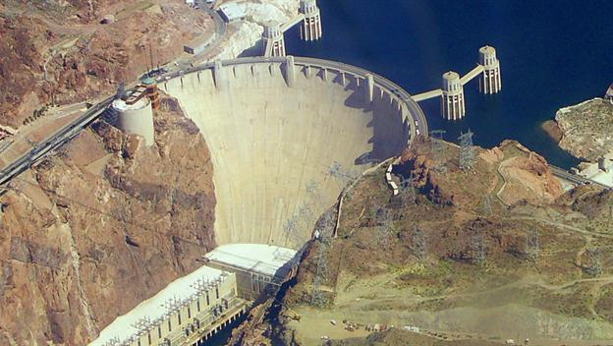

Slide 8
Hoover Forced to Take Action
Election of 1930
Democrats take control of the House of Representatives
President Hoover now took an active role in aiding the nation’s problems
Federal Farm Board
Intended to raise crop prices by buying crops and keeping them off market until prices went up
National Credit Corporation
Big bank that loaned money to small banks to keep them out of bankruptcy

Slide 9
Hoover Takes a Different Intervention
1931 is an election year
Federal Farm Board and National Credit Corp doesn’t work
Hoover appeals to Congress to pass the Federal Home Loan Act
Lowered mortgage rates for homeowners and allowed farmers to refinance their farm loans
Reconstruction Finance Corporation
Gave $2 billion for emergency financing for banks and large businesses; “TRICKLE DOWN EFFECT”

Slide 10
Bonus Army

Slide 11
Bonus Army
Spring of 1932
20,000 WW I veterans marched on Washington, D.C.
Led by Walter Walters
Came to support the Patman Bill
Authorized the government to pay a bonus to WW I veterans who had not been compensated adequately for the wartime service.
Bill was passed in 1924, but the soldiers were not to be paid until 1945 in the form of cash and life insurance

Slide 12
What happened to the Bonus Army?
Hoover called them “communists and persons with criminal records”
Evan so, he respected their rights to assemble
Gave food and supplies for them to make a shantytown near the Capitol Building
When Patman Bill fails, Hoover asked them to leave
Do They??

Slide 13
Hoover Calls in the Army
Led by General Douglas MacArthur, troops gassed and burned the shantytowns of the remaining veterans

Slide 14
November 1932
Hoover’s public image is suffering due to the Depression
Democrats have a formidable opponent with a popular name
Franklin D. Roosevelt

