Slide 1
Industrial Revolution
Changes in how things are made

Slide 2
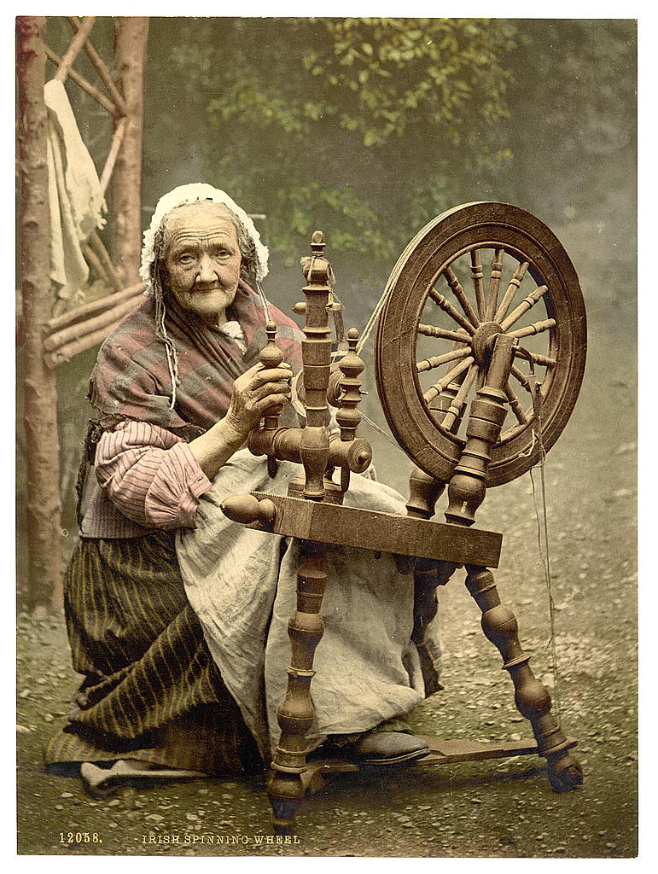
Cottage Industry
Until the late 1700s most goods around the world were produced by cottage industry
Cottage Industry: when goods are produced in one’s home

Slide 3
Cottage Industry
Advantages of Cottage Industry
Quality Product Produced
Unique Products Produced
Low start up costs
Creates skilled jobs which pay high wages

Slide 4
Cottage Industry
Disadvantages
Production is slow
High rate of skill necessary to produce
Goods are expensive
Custom made goods are hard to repair

Slide 5
Industrialization
Machines begin to do repetitive tasks for the production of finished goods
Advantages-
Creates more jobs
Increases size of middle class
Prices of finished goods decrease
Increases variety of finished goods for purchase

Slide 6
Industrialization
Disadvantages of Industrialization
Large amounts of money (capital) needed to start mechanized manufacturing
Decreased demand for skilled labor
Decreased pay for skilled labor
People work away from home

Slide 7
Industrial Revolution
Begins in Europe during the mid 1700s
The textile mill was the first to industrialize

Slide 8
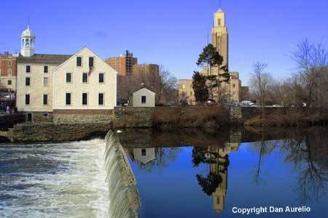
Industrialization Comes to America
Samuel Slater (Great Britain)
Smuggles plans for a textile mill from Britain to U.S. (1790s)
Convinces Almay and Brown to finance the building of his first mill in Pawtucket, Rhode Island

Slide 9
Rhode Island System
Slater hires entire families to work in his mill
Slater’s mill produces thread which was woven by local families

Slide 10
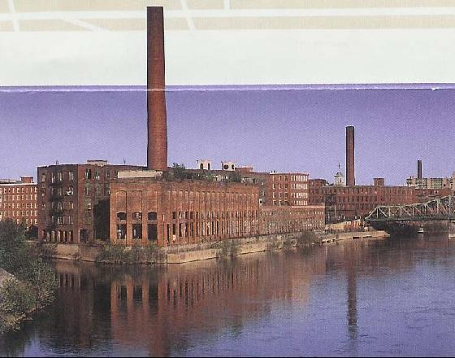
Industrialization Comes to America
Francis Cabot Lowell
Creates first “integrated textile mill” where fibers are turned into finished cloth under one roof

Slide 11
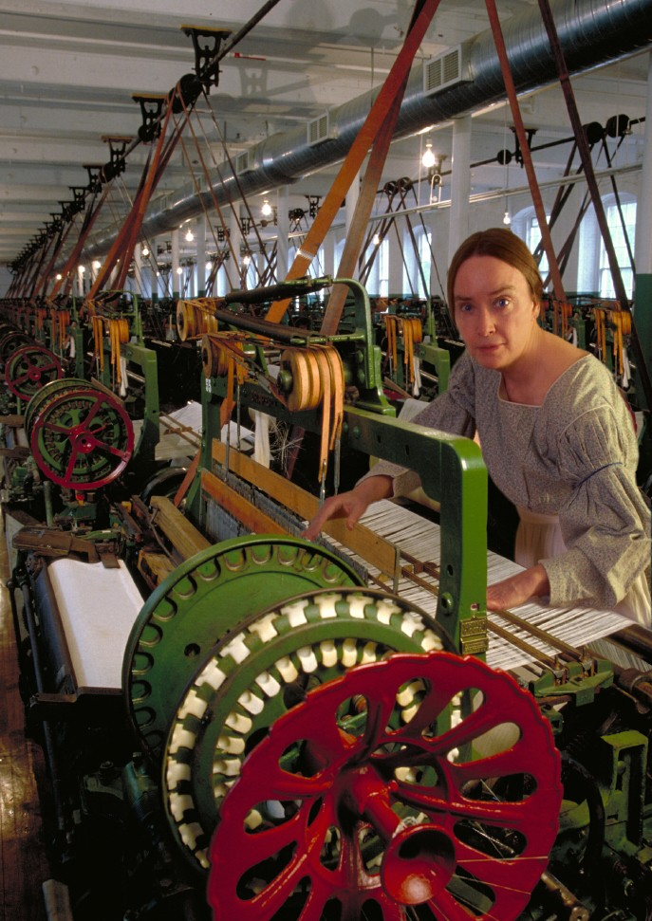
Lowell System
Hired local girls to work in his mills

Slide 12
Workers Unite
Sarah G. Bagley
As competition increases working conditions deteriorate and wages decrease
Lowell Female Labor Reform Association (1844)
Labor Union formed to improve working conditions for factory workers
Fought for 10 hour work day

