Slide 1
World Goes to War

Slide 2
World War I Breaks Out
Long term tensions erupt into a devastating war among European nations, while the US tries to remain neutral

Slide 3
Eyewitness to History
“As I write, Germany is reported to have declared war against Russia and France, and participation of England on the one side and of Italy on the other seems close at hand. Nothing like it has occurred since the Napoleonic wars, and with modern armaments and larger populations noting has occurred since the world began…All of Europe is to be like a battle ground…The future looks dark indeed”
Ex-President William H. Taft, 1914

Slide 4
Causes of World War I
As an industrial and imperial power, America felt the same pressure that had led Europe into warfare:
Nationalism
Imperialism
Militarism
System of alliances

Slide 5
Nationalism
Nationalism= an intense devotion to the interests and culture of one’s nation
Influenced politics greatly
Ethnic groups resented domination by others
Longed for their nations to become independent
Why was politics influenced by nationalism?
It usually led to competitive rivalries among nations
Examples: Serbia was an independent nation with a Serb majority population. (Russia was protector of Serbs) However, millions of Serbs lived in Austria-Hungary empire. Thus, Russia and Austria-Hungary were rivals

Slide 6
Effects of Imperialism
For many centuries, European nations (Britain, France, & Germany) had been building empires across the world
Effects of imperialism
Ethnic populations are politically controlled by other countries
Empires needed colonies because the colonies provided
Raw materials
New markets for manufactured goods

Slide 7
Militarism
Nationalism and imperialism led to increased military spending
Each nation wanted stronger armed forces than those of its rivals.
Militarism = the development of armed forces and their use as a tool of diplomacy
By 1890s, Germany was the strongest nation in Europeans
Had set up an army reserve system that drafted and trained young men

Slide 8
Kaiser Wilhelm II
(1887) German Emperor who decided that his nation should become a major naval power in order to compete with Britain
Britain had the largest navy in the world up to this point
After 1897, Germany and Britain compete to build the largest battleships and destroyers.
Eventually France, Italy, Japan, and the US join the race

Slide 9
Alliance Systems
By 1907, there were two defense alliances in Europe
Triple Entente
(Later known as the Allies)
France
Britain
Russia
Triple Alliance
Germany
Austria-Hungary
Italy (later drops out)
Later named the Central Powers
Germany
Austria-Hungary
Ottoman Empire
Empire of mostly Middle Eastern lands controlled by the Turks

Slide 10
An Assassination Leads to War
The Balkans were full of ethnic rivalries among their peoples:
Serbs
Bosnians
Austrians
Croats
All of them wanted their own independence from Austria-Hungary.

Slide 11
The Fuse is lit…
Archduke Franz Ferdinand
Heir to the Austrian throne
Visited Sarajevo, Bosnia in 1914 on good will tour with wife
Large population of Serbs live in Bosnia
Gavrilo Princip
Serbian national
Member of Black Hand
Shot and killed the archduke and his wife
Why? Because he wanted to promote Serbian nationalism

Slide 12
Powder Keg Explodes
Alliance System pulled one nation after another into conflict
Austria-Hungary declared war on Serbia
Russia (Protector of Serbs) mobilized to help Serbia
Germany declared war on Russia and France (Russia’s ally)
Germany invaded France through Belgium who was siding with France and Britain
Britain declares war on Germany

Slide 13
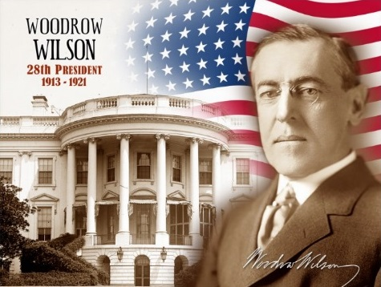
Neutrality
At beginning of the war Woodrow Wilson declares US Neutrality that lasts for the first three years of the war.

