Slide 1
Life During the Gilded Age

Slide 2
Life During the Gilded Age
Look at the following images and determine what life during the Gilded Age was like based on the images provided
Be prepared for your group to explain to the class what your group has described and to explain if you believe the images you were provided were credible.

Slide 3
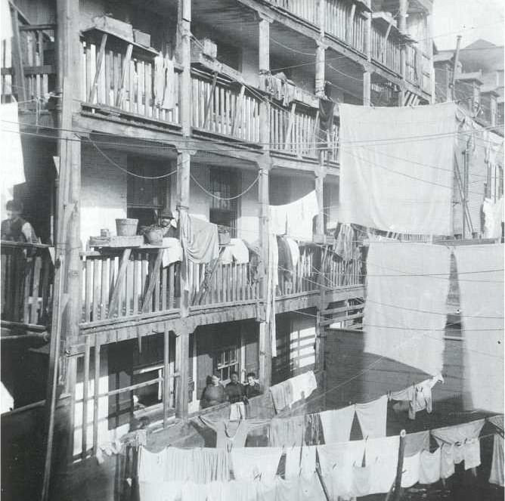

Slide 4
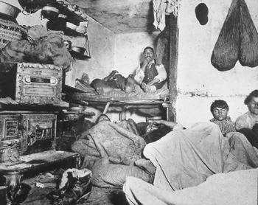

Slide 5
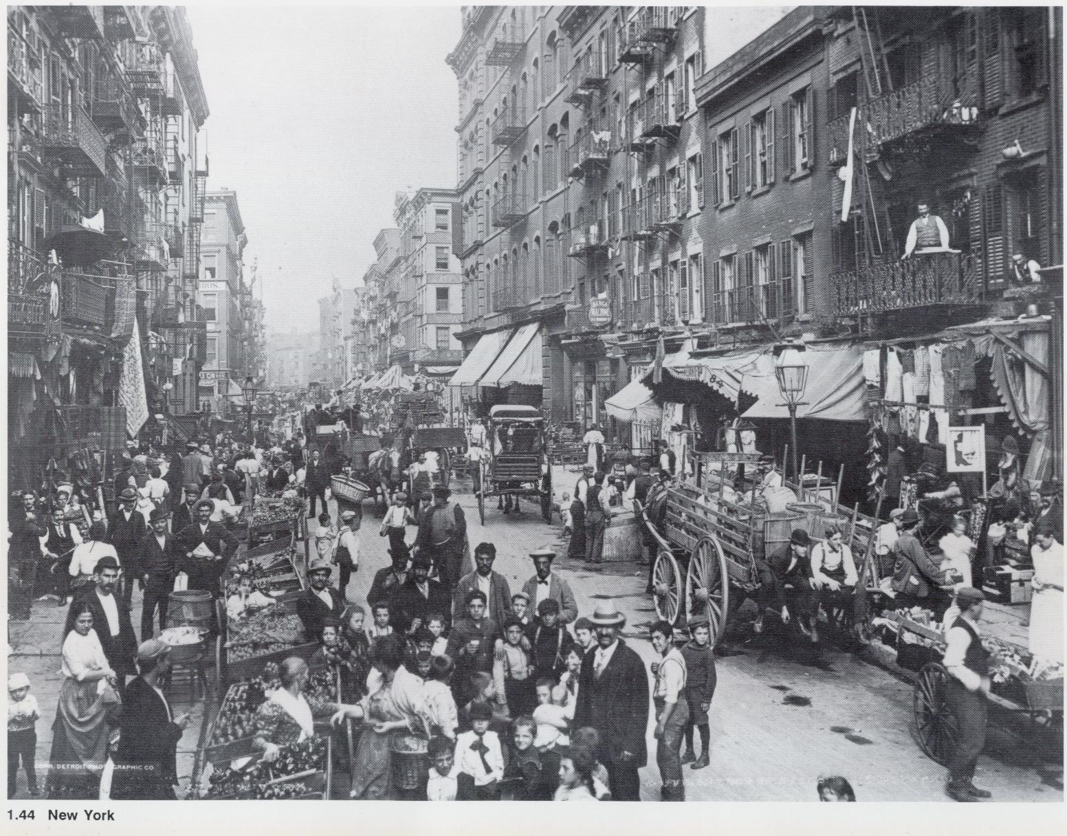

Slide 6
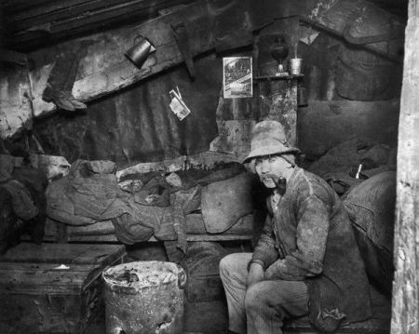

Slide 7
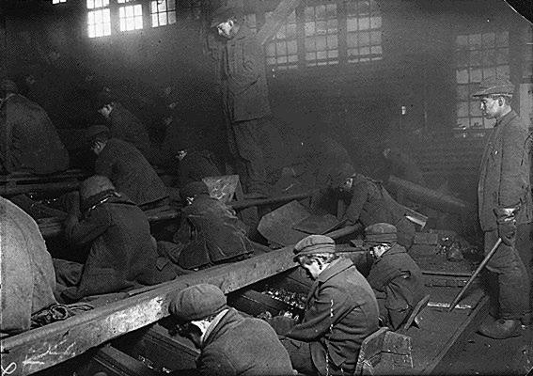

Slide 8
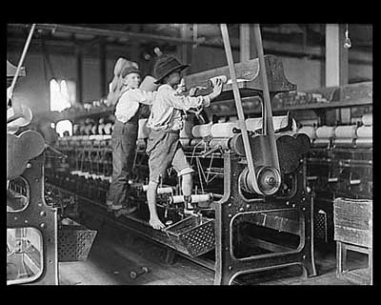

Slide 9
