Slide 1
Life During the 1920s
Prohibition and the Scopes Monkey Trial

Slide 2
Prohibition
Midnight, January 16, 1920 The United States went dry
Goal- To reduce crime and poverty and to improve the quality of life by making it impossible for people to get their hands on alcohol

Slide 3
Prohibition
This was the first time citizens rights were taken away by a constitutional amendment
18th Amendment (Volstead Act)
Prohibited the manufacture, sale and possession of alcohol in the US

Slide 4
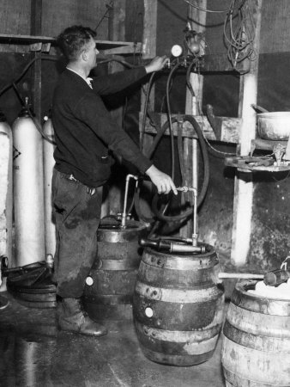
Effects of Prohibition
An industry of Bootlegging, speakeasies, and Bathtub Gin was born
People drank more than ever during Prohibition, and there were more deaths related to alcohol

Slide 5
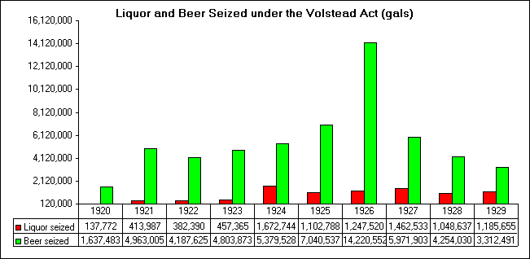
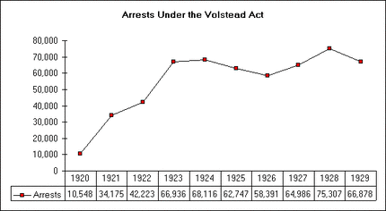
Effects of Prohibition
No other law in US has been violated so flagrantly by so many decent “law-abiding” people

Slide 6
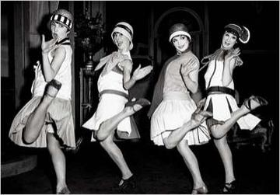
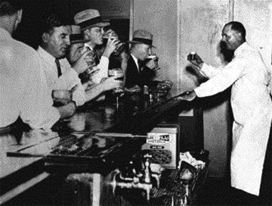
Effects of Prohibition
Mobsters controlled liquor created a booming black market economy
Gangsters owned speakeasies and by 1925 there were over 10,000 speakeasies in New York City alone

Slide 7
St. Valentine’s Day Massacre 1929
Al Capone and his group of mobsters controlled liquor sales in Chicago
Capone’s gang cornered a rival “Irish Gang” disguised as police then gunned them down
Elliott Ness “Untouchables”
Federal Prohibition Bureau special agents used to go after gangsters
Not susceptible to bribes like corrupt local cops
1931 arrest and convict Al Capone

Slide 8
Prohibition The “Noble Experiment”
Prohibition is an awful flop.
We like it.
It can’t stop what it’s meant to stop.
We like it.
It’s left a trail of graft and slime,
It’s filled our land with vice and crime,
It can’t prohibit worth a dime,
Nevertheless we’re for it”
Franklin Pierce Adams, New York World

Slide 9
Prohibition Fails
21st Amendment repeals prohibition in 1933

Slide 10
Scopes Monkey Trial
1st conflict between religion vs. science being taught in school
1925
Dayton, Tennessee
Trial conducted in a carnival-like atmosphere
People of Dayton are seen as “backward” to the country

