Slide 1
Stamp Act
Colonial Reactions

Slide 2
Stamp Act
Stamp Act required all colonists to pay a small tax on all printed items
Purpose
Pay for the running of the British Empire (defense)
Make colonial tax policy more like taxes in Britain

Slide 3
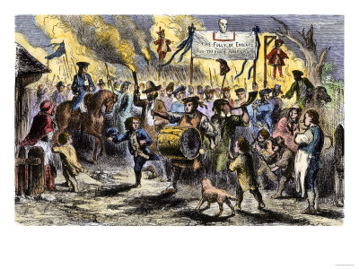
Colonial Reaction to the Stamp Act
Speeches and Editorials to unite the people living in the colonies
Sam Adams forms Committees of Correspondence to unite colonial protests
Stamp Act Congress and colonial leaders send petitions to Parliament
Sons of Liberty use violence to frighten tax collectors
Boycott British products

Slide 4
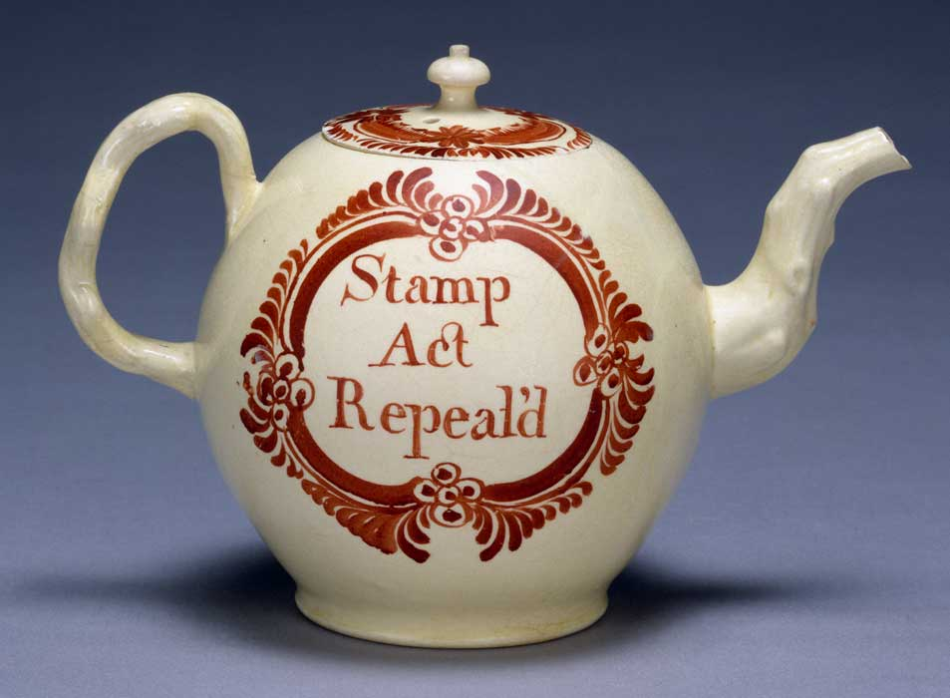
Stamp Act Repealed
February 1766 Parliament repeals the Stamp Act causing many colonists to rejoice and respect their government for listening to their requests

Slide 5
Parliaments Next Move
Many people in England fear that giving in to the colonists demands will lead to further rebellion and even economic competition from the colonies

Slide 6
Parliaments Next Move
June 1766 Parliament passes the Townshend Acts which
Tax imported lead, glass, paint, paper, and tea
Will use money to pay for the military and the salaries of Royal Governors
Creates Writs of Assistance
Writs of Assistance- search warrants that allow British officials (soldiers) to search for smuggled items

Slide 7
Reaction to the Townshend Acts
Cause tensions in the colonies to rise, especially in Boston, Massachusetts

