Slide 1
Manifest Destiny
America’s Movement into the Far West

Slide 2
Mexican Independence
Until 1824 Mexico part of the Spanish Empire

Slide 3
Republic of Mexico
Needs to populate its northern provinces of Texas, New Mexico, and California
Allow Americans to become empresarios
Empresario- agent to bring people to an area in return for land
1st American empresario Stephen F. Austin

Slide 4
Republic of Mexico
American immigrants must agree to
Be loyal to Mexican Government
Become Catholic
Not bring slaves into Mexico
Explain why Americans moved to Texas (3)

Slide 5
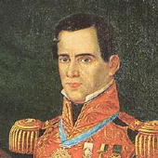
Mexican Leadership Changes
General Antonio Lopez de Santa Anna elected president then suspend Mexican Constitution

Slide 6
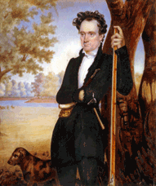
Texans Protest
Anglos and Tejanos protest Santa Anna’s actions
Anglo- English speaking person in Texas
Tejano- Spanish speaking people in Texas
Send Stephen F. Austin to negotiate with Santa Anna

Slide 7
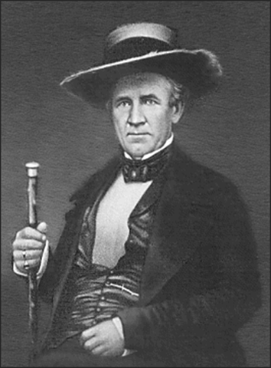
Texas Protests
Form a militia made up of Anglos and Tejanos and led by Sam Houston to defend the province

