Slide 1
The American Revolution
Choosing Sides

Slide 2
American Revolution
Colonial Population will split into three segments.
Your economic status and your beliefs on the source of government power will determine which group you belong to

Slide 3
The American Revolution
Patriots
Make up about 1/5 of the population at the beginning of war
Upper middle class landowners and businessmen
Believe in ideals of the Enlightenment

Slide 4
The American Revolution
Enlightenment
During the 1700s many scholars began to question the world around them (Call this the Enlightenment)
John Locke- (leading English Enlightenment Philosopher)
Believed that the government worked for the people
People had certain rights such as equality and liberty that could not be taken away
Believe that English documents support these beliefs
Magna Carta, English Bill of Rights, Petition of Rights

Slide 5
The American Revolution
Enlightenment Beliefs
Natural Law- there is and unchanging set of laws that govern human relations that comes from God
There is a social contract between the government and the people in which the government’s job is to protect the people’s natural rights of life, liberty and property
John Locke teaches that if the government does not uphold those rights the people can replace their government with one that will uphold the citizen’s natural rights

Slide 6
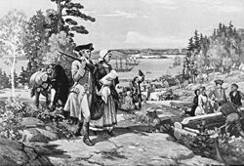
The American Revolution
Loyalist
Made up 1/5 of the Colonial Population at the beginning of the war
Often large land owners, merchants and employees of the British Government (work for king)
Enjoy the security of a strong government
Don’t believe rebellion is the way to solve political problems
Believe in the traditional flow of power from government to the people

Slide 7
The American Revolution
Neutral Colonists
Make up 3/5 of Colonial Population
Usually lower economic class (poorer)
Too busy with other concerns to worry about political squabbles
Believe that no matter who is in charge of the government it will not understand their needs

Slide 8
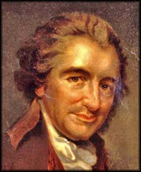
Thomas Paine
Publishes a pamphlet titled Common Sense
People, not kings, should make laws therefore monarchies are unfair

Slide 9
Common Sense
It is only common sense that a continent should not be ruled by an island
“A government of our own is our natural right”

