Slide 1
The Rise of Big Business
Chapter 6 Section 2

Slide 2
Rise of Big Business
Capitalism- Economic system in which private business run most of the industries and competition determines how much goods cost and workers are paid.
System the US operates under

Slide 3
New Capitalist Spirit
In the 1800s entrepreneurs set out gain economic wealth by building industries that took advantage of the era technological advances
Most businessmen believed the economy would prosper if business were left free of government regulation
This belief is known as Free Enterprise

Slide 4
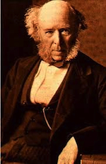
Social darwinism
Proposed by Edwin Spencer (Great Britain)
Believe society progresses though natural competition.
Fittest people, businesses, or nations survive and “unfit” fail
Leads to belief of Laissez-faire

Slide 5
Corporations
Corporation- organizers raise money for business by selling stock (certificates of ownership) in the company
Trust- a group of companies turn over control of their stock to a common board of trustees
Monopoly- If trust gains complete control of an industry . Allows the monopoly complete control over price and quality of product.

Slide 6
The rise of Big Business
“Robber Barons”
“Captains of Industry
Business leaders built their fortunes by stealing from the public
The persuaded public officials to interpret laws in their favor
They ruthlessly drove their competitors to ruin.
They paid their workers low wages
The business leaders served their nation in a positive way
They raised productivity and expand markets
They created jobs that enabled many Americans to buy new goods and raise their standard of living

Slide 7
Andrew Carnegie
Andrew Carnegie
Captain of Industry
Monopolized the steel industry
Rags to riches story- came from Scotland very poor
Used scientific ideas (Bessemer Process to) develop a better way to produce steel and sell quality product for inexpensive price.
Used Horizontal Integration

Slide 8
Andrew Carnegie
Andrew Carnegie
Captain of Industry
Believed that the Anglo-Saxon race is superior
“Gospel of Wealth” (1889) stated that inevitable and good.
Wealthy should act as “trustees” for their “poorer brethern.”

Slide 9
John Rockefeller
John D. Rockefeller
Captain of Industry
Came from a wealthy family
Formed the first modern corporations in the oil industry. Standard Oil
Was the first billionaire in the U.S. by 1900
Used vertical Integration and Horizontal Integration to gain a monopoly in the oil business

Slide 10
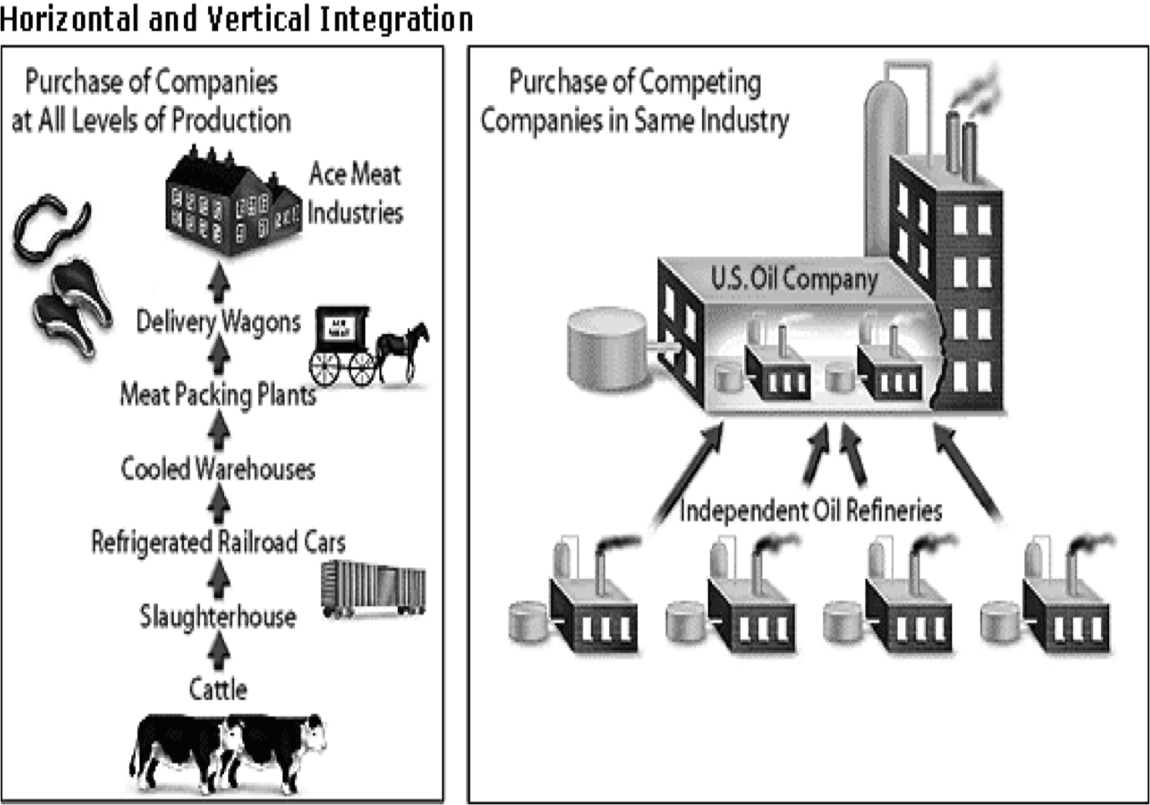
Vertical Integration: Control all phases from the raw material to the finished product
Horizontal Integration: Buy out your competition until you have control of a single area of industry

Slide 11
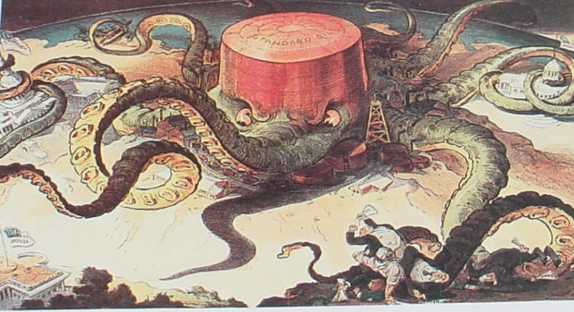
Rockefeller would be hated by many because he had too much control over the oil industry and government as viewed by the common man----Some believed he was corrupt because he took away the right to compete---- free enterprise

Slide 12
Questions of the Day
How did business practices change during the Second Industrial Revolution?
How do Carnegie and Rockefeller exemplify the changes in American Business during this era?
Compare vertical and horizontal integration.

